Slide 1

October 15, 2026
HR1 Stakeholder Webinar 2
Federal Changes
to NJ FamilyCare
for Expansion Adults
Webinar 2: Scenarios and Timelines
What hospitals, clinical providers, assistors,
navigators, community organizations,
and government partners need to know
Together, We Can Help
NJ Stay Covered
IMPORTANT:
Changes begin January 1, 2027.

Slide 2
Recap: What Is Changing
What's happening?
Who is affected?
Why does it matter?
The federal law (OBBBA/H.R. 1) creates new rules for
NJ FamilyCare starting
January 1, 2027:
Work/community
engagement requirements
6-month renewals
Shorter retroactive coverage
Community engagement requirements apply to more than 540,000 New Jerseyans, about 30% of the NJ Medicaid population.
More than 300,000 New Jerseyans could lose coverage. Members are most likely to lose coverage through missed mail and paperwork, which means the people they already trust, including people like you on this webinar - providers, assistors and navigators, are the best chance to keep them covered.
IMPORTANT: Trusted partners are essential to keeping eligible members covered.

Slide 3
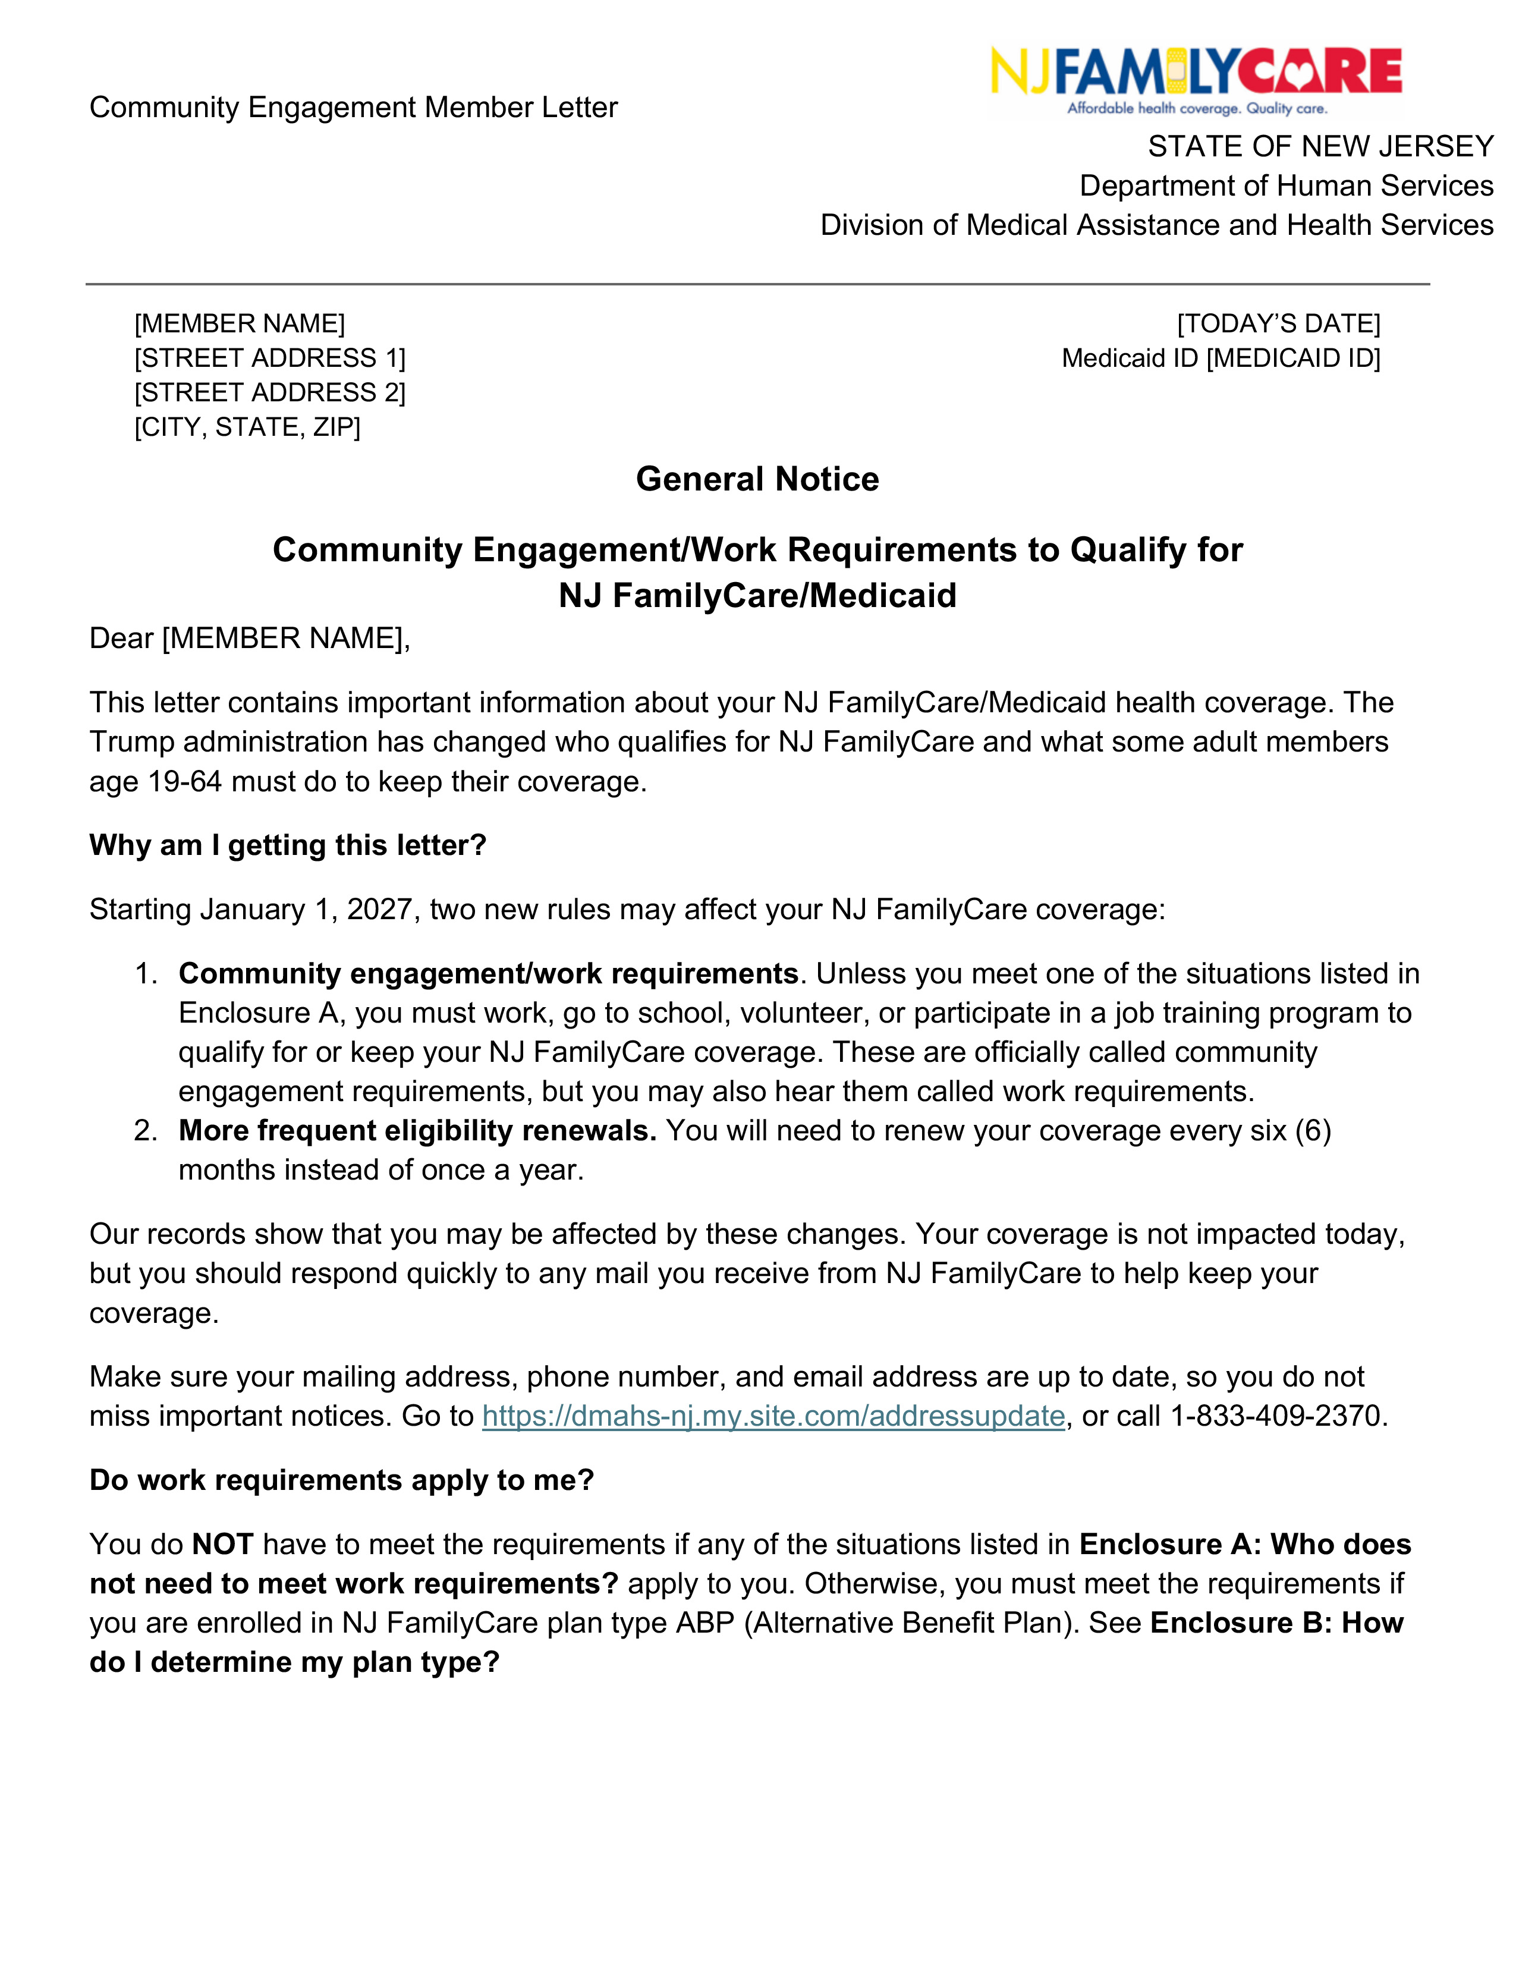
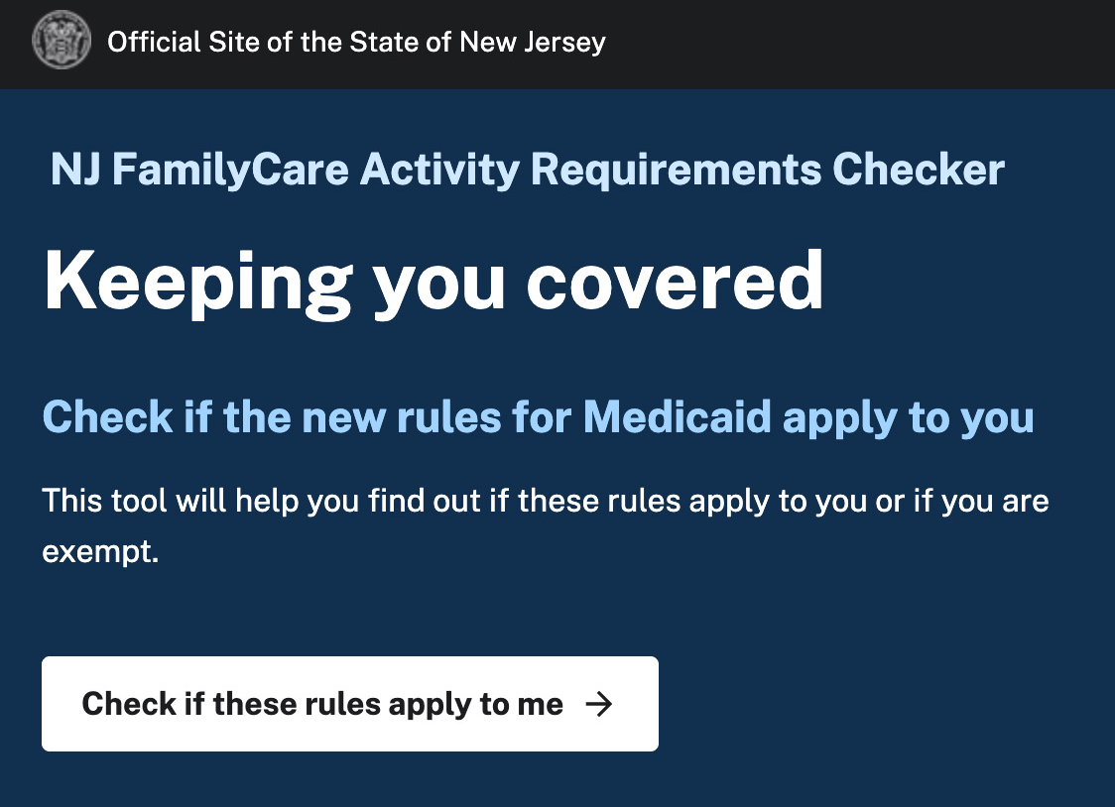
4 Steps Every Member Should Take
UPDATE Contact Information
Make sure the mailing address, phone number,
and email address are correct.
Link: dmahs-nj.my.site.com/addressupdate
1
2
WATCH for Messages
Open mail and read emails or text messages
from NJ FamilyCare and the health plan.
Complete the CHECKER
Use the NJ FamilyCare Activity Requirements Checker
to understand whether work requirements, exclusions,
or exceptions may apply.
Link: www.njfcchecker.nj.gov
3
4
RESPOND on Time
Send requested information by the deadline in the notice.

Slide 4
What We Are Hearing
Top topics from
your questions
How to
ask questions
How we triage
and respond
Who must meet work requirements
Exclusions and exceptions
(SNAP, ABD, DDD, MLTSS)
Showing income, hours,
and other activities
Retroactive coverage
and effective dates
Appeals and authorized representatives
Presumptive Eligibility
Training and materials
Webinar chat:
during any Quality Institute webinar
Email:
HR1feedback@njhcqi.org
Office hours:
Thursdays, 1:00 to 2:00 pm on Zoom
Every question is logged and grouped by topic.
We answer from current DMAHS guidance when we can.
New or unclear questions go to DMAHS at our weekly check-in.
Answers are shared through FAQs, office hours, and webinars.
IMPORTANT: Do not send patient-specific or personal information. Share the issue, not the person

Slide 5
Updates: Who Must Meet Work Requirements
If The Person Is... | Then...
65 or older | Not affected
Enrolled in ABD (Aged, Blind, Disabled) | Excluded
In a SNAP household and meeting SNAP work rules | Excluded
Receiving DDD services or in MLTSS | Not automatically excluded. Check for ABD or medical frailty
Getting emergency Medicaid for an emergency | Work requirements do not apply
Enrolled through Presumptive Eligibility | Work requirements apply at the full application if the person is an Expansion Adult
Previously disenrolled | Must apply again as a new applicant
Participants in a drug addiction or alcohol treatment and rehabilitation program | Excluded
Pregnant individuals (including non-citizens) | Excluded
Medically Frail | Excluded
IMPORTANT:
Do not guess.
Use the Activity Requirements Checker and
the member’s
official notice.

Slide 6
Updates: Meeting and Demonstrating the New Requirement
QUESTION:
ANSWER:
Which month counts?
New applicants: the month before applying.
Renewals: any one month since the last renewal.
Is $580 in income enough
without 80 hours?
Yes. Either one meets the requirement.
What about seasonal work?
Average monthly income over the prior 6 months can be used.
What needs documents
in 2027?
Only income, work hours, school, and VA disability,
and if NJ FamilyCare asks for additional documentation.
What can members
self-attest (report) in 2027?
Volunteering, job training, medical frailty, and recent hospital stays.
Are applications changing?
Members apply in the same ways. New rules are built-in
behind the scenes and as part of the application.
IMPORTANT: Keep records now. Do not send documents unless NJ FamilyCare asks.

Slide 7
Key Dates
Eligible uninsured adults should apply before January 1, 2027.
Prepare. Update contact information, use the Checker, find
a qualifying activity.
Applications submitted follow current rules,
even if processed later.
New rules take effect.
Renewal packets go out
for March 2027 renewals,
the first group affected.
Now to
December 31, 2026
Before January 1, 2027
January 1, 2027
January 2027
Requests for Information (RFIs) go out. Members have 14 or 30 days to respond.
First possible
coverage losses.
A new group renews.
Each Expansion Adult renews every 6 months.
Stricter documentation rules begin.
February 2027
End of March 2027
Every Month After
January 2028

Slide 8
Scenarios: Four Members, Four Outcomes
Maria
New Applicant
David
Current Member
Hector
Current Member
Sofia
Current Member
Situation:
Applies for NJ FamilyCare for the first time. Volunteers 20 hours
a week at a food bank.
Outcome:
Self-reports volunteering. Meets the requirement. Enrolled, and reviewed again in 6 months.
Situation:
Earns about
$1,200 a month
at a grocery store.
Outcome:
State wage data
shows he earned more than $580 in a month. Renewed with no action.
Situation:
Cares for his brother’s
8-year-old son, who lives with Hector.
Outcome:
Checks the caregiver
box on the renewal form. Excluded. No other documents needed.
Situation:
Drives for a rideshare
app 20 hours a month, earning $400.
Outcome:
Does not meet $580 or 80 hours. Coverage ends.
Can buy a GetCoveredNJ plan, but no subsidy.
IMPORTANT: Ask about caregiving, medical frailty and other exclusions when assisting a member with their application or renewal. The state only has access to limited data sources to automatically renew coverage.

Slide 9
Scenarios: Maria, New Applicant
Maria applies for NJ FamilyCare for the first time.
She volunteers 20 hours a week at a food bank.
April 2027
Maria volunteers 20 hours a week. For a new applicant,
the month before applying is the month that counts.
IMPORTANT: Volunteering can be self-reported
in 2027. For new applicants,
the requirement
has to be met
the month
before applying.
May 4, 2027
Maria applies and self-reports that she volunteered 20 hours a week in April.
Around
June 2027
Maria gets an enrollment notice saying she meets the work requirement.
May 1 to
October 31, 2027
Maria has coverage. Her eligibility is reviewed again in 6 months.

Slide 10
Scenarios: David, Current Member
David works at a grocery store and earns about $1,200 a month.
His current enrollment is until September 30, 2027.
Around
July 2027
IMPORTANT:
When state data shows the requirement is met, the member does not need to act. Members should still watch for notices informing them that they are eligible and will continue to remain enrolled.
David's current enrollment period ends in September 2027. About 2 months before the end of the enrollment period, the state checks its data sources
to try and automatically verify David's eligibility, including using wage data.
It shows David earned more than $580 in at least one month of his current period, so the state renews him without asking for anything.
David gets a renewal notice saying he meets the work requirement.
Around
August 2027
September 30, 2027
David's current eligibility period ends and he has already been automatically verified to continue coverage for another 6 months.
David has coverage for the next 6-month period. His eligibility is reviewed
again in 6 months.
October 1, 2027 to March 30, 2028
IMPORTANT: When state data shows the requirement is met, the member does not need to act. Members should still watch for notices informing them that they are eligible and will continue to remain enrolled.

Slide 11
Scenarios: Hector, Current Member
Hector recently started caring for his
brother's 8-year-old son, who lives with him.
Hector gets a renewal packet. The state could not renew him automatically because its data does not show that he meets or is excluded from the work requirement.
He must show he met it in any month since his last renewal, or that he is excluded. He has 30 days to respond.
IMPORTANT:
Help your clients review and answer questions about exclusions and exemptions.
The state does
not have access
to this information and data.
July 20, 2027
Hector returns the packet. He says he cares for a child under 14 who
lives with him. That qualifies him for the caregiver exclusion, and he does
not need to send other documents.
August 10, 2027
The state renews Hector based on his response to being a caregiver
for a child under 14.
September 3, 2027
Hector gets a renewal notice saying he is excluded from work requirements.
September 14, 2027
Hector has coverage in the next enrollment period.
His eligibility is reviewed again in 6 months.
October 1, 2027 to March 30, 2028
Notes:
Play with green tints

Slide 12
Scenarios: Sofia, Option 1 (No Support)
Sofia drives for a rideshare app 20 hours
a month and earns $400 a month.
Sofia gets a renewal packet. The state could not renew her automatically.
She has 30 days to show she met the work requirement in any month since
her last renewal, or that she is excluded.
July 20, 2027
IMPORTANT:
Respond by every deadline and share every activity or exclusion that applies. Help connect Sofia to free or low-cost care resources to maintain access to healthcare if she cannot afford to purchase a plan from GetCoveredNJ.
Sofia returns the renewal packet.
August 10, 2027
The state cannot confirm her eligibility from the renewal forms and sends a Request for Information (RFI).
September 3, 2027
Sofia gets the RFI. She has 30 days to respond.
September 7, 2027
Sofia returns the RFI with app screenshots showing 20 hours and $400 a month.
September 15, 2027
The state finds Sofia ineligible. She does not meet $580 or 80 hours, and no exclusion or exception applies. The state sends a termination notice.
September 17, 2027
Sofia gets the termination notice.
September 20, 2027
Sofia's coverage ends. She can buy a GetCoveredNJ plan but is not eligible for subsidies under federal rules, so she will have to pay the full premium.
September 30, 2027

Slide 13
Scenarios: Sofia, Option 2 (With Trusted Partner Support)
Sofia drives for a rideshare app 20 hours a month and earns $400 a month. With help from a navigator at her local public library, she adds volunteer hours to her work hours to meet the requirement.
Sofia visits a navigator at her local public library. Using the Activity Requirements Checker, the navigator explains that 20 hours and $400 a month does not meet $580 or 80 hours. Sofia needs 60 more hours in one month. No exclusion applies.
June 1, 2027
IMPORTANT:
Hours from different activities can be combined
to reach 80 hours, such as work plus volunteering or work plus school. Libraries and other trusted partners can help members plan ahead and keep records.
June 2027
Sofia keeps driving 20 hours and volunteers 60 hours at a local food pantry. She saves her app screenshots and keeps track of the number of hours she volunteers. The food pantry also keeps
a record of all of their volunteers’ hours.
Sofia gets a renewal packet. She has 30 days to show she met
the work requirement in any month since her last renewal.
July 20, 2027
Sofia and the navigator complete the packet. Sofia reports June as her month: 20 hours of rideshare work, shown with app screenshots, and 60 hours of volunteering, which she can
self-report. Sofia returns the packet.
August 10, 2027
September 3, 2027
The state confirms 80 combined hours in June and renews Sofia.
September 14, 2027
Sofia gets a renewal notice saying she meets the work requirement.
October 1, 2027
Sofia has coverage until the next enrollment period. Her eligibility is reviewed again after 6 months.
Notes:
Adjust tints on all so darker shade w darker tint

Slide 14
What You Can Do
Hospitals and
Clinical Providers
Code conditions accurately. Ask about coverage at check-in and discharge. Help with the medical frailty screener. Start applications during admission.
Assistors
and Navigators
Help with packets, RFIs, and the screener. Prioritize members with unstable housing or limited English. Track reconsideration deadlines.
Community
Organizations
Share DMAHS materials.
Host renewal events with assistors.
Offer space and computers.
Local, County,
and State Government
Share DMAHS materials. Connect members
to workforce, volunteer, and training programs.
Provide records of hours when asked.
All Partners
Know your local safety net: identify nearby
Federally Qualified Health Centers and free clinics
and have referral information ready for patients
who lose NJ FamilyCare coverage.
Support members, but do not promise eligibility. NJ FamilyCare makes the decision.

Slide 15
State Resources and Support
Activity Requirement Checker
www.njfcchecker.nj.gov
Federal Changes Information
MedicaidWorkRules.nj.gov
Update Contact Information
and Opt in to Texts/Emails
dmahs-nj.my.site.com/addressupdate
Apply or Reapply
Online (preferred) or via NJ FamilyCare
at 1-800-701-0710 or the County Social Service Agency
Assistor Training Waitlist
MAHS.NJFamilyCare@dhs.nj.gov
z
Free Legal Help
Legal Services of NJ at
1-888-576-5529

Slide 16
Quality Institute Resources and Support
Quality Institute Questions Inbox
Quality Institute
Office Hours
Slides and
Recordings
HR1feedback@njhcqi.org
Thursdays, 1:00 to 2:00 pm
on Zoom
njhcqi.org/hr1
Next Webinar: December 3, 2026, 12:00 to 1:00 pm

Slide 17
Remember These 4 Words
UPDATE. WATCH. CHECK. RESPOND.
Update contact information.
Watch for NJ FamilyCare messages.
Complete the checker.
Respond by every deadline.
Sources: NJ FamilyCare Work Requirements webpage, September 2026; NJ FamilyCare Stakeholder Resources webpage, September 2026; Expansion Adult Stakeholder Guidance, September 4, 2026 (not final); NJ FamilyCare Activity Requirements Checker, www.njfcchecker.nj.gov

