Slide 1
TeamBirth Lunch & Learn
May 2025
Notes:
Breakout Session Timing: 50-60 minutes total
Welcome In!

Slide 2
Internal planning
Section | Agenda Items | Notes | Facilitator(s)
Session welcome & learning objectives [5 mins] | Introductions Session objectives | Clarifying that this session builds on the LMS video content and confirm that attendees have completed LMS content This session is the first step towards trying out and practicing the TeamBirth key behaviors. Simulating and practice teambirth scenarios will happen next
What is TeamBirth [10 mins] | Core Components Our board When to huddle Key resources | This brief intro to TeamBirth grounds people on the big picture and key resources (board design, 1 & 2-pagers) Practice keeping each slide to ~ 1 min of voiceover (see speaker notes for approximate recommendations)
TeamBirth Key Behaviors [30 mins] | Sparking a huddle & Team Demo + Practice Preferences Demo + Practice Plan Demo Next Huddle Demo | These practice opportunities are bite sized and intended to help get the words out for introducing huddles and asking different open-ended questions Share the scripts (in the slide speaker notes) with Demo readers Decide for your group if you want to take questions as they come or wait until after this section content is covered
Practice [10 mins] | Scenario 2 practice facilitation | This can be done in a more or less structured way depending on the group Ideally have a whiteboard with markers on hand to write out the board

Slide 3
Learning Objectives
To describe what TeamBirth is and why it is valuable
To identify opportunities for when TeamBirth Huddles may occur
To begin practicing demonstration of the TeamBirth Key Behaviors while using the shared planning board:
Team: To promote the role of each team member
Preferences: To elicit patient preferences, thoughts, & concerns
Plan: To distinguish the different care plans
Next Huddle: To set shared expectations for the timing of the next huddle
Notes:
*briefly show and read through the learning objectives (or goals) for the session to kick things off*

Slide 4
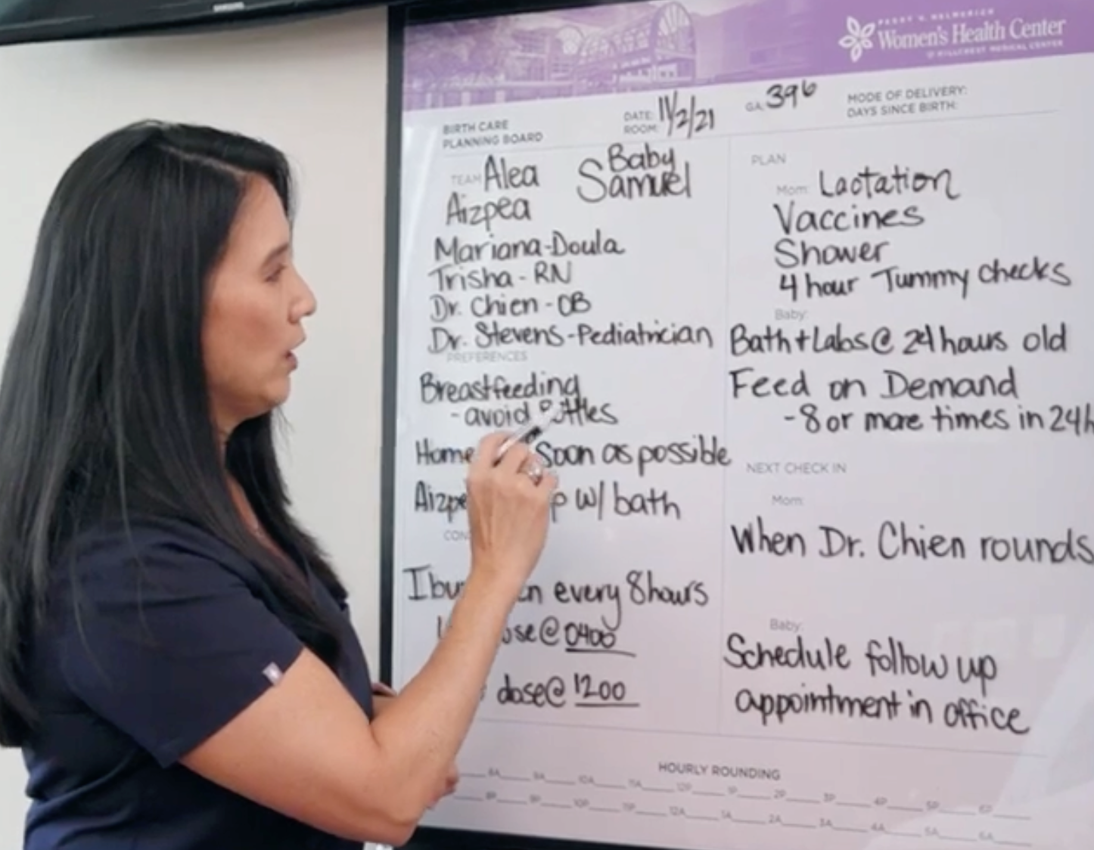
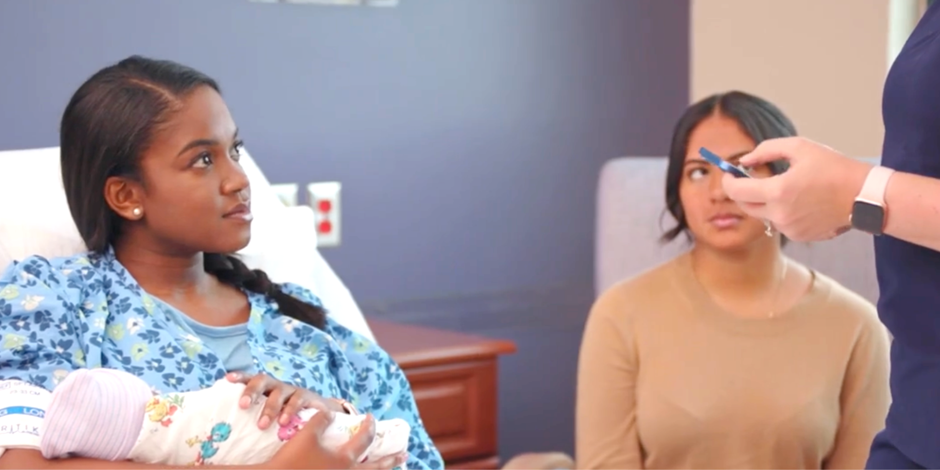
What is TeamBirth?
Notes:
(10 secs)
We’ll start with a brief overview of TeamBirth which should be familiar for you after completing the TeamBirth training videos.
If you don’t know what I’m talking about when I say TeamBirth training videos or haven’t watched them yet, please make sure you check in with me before you leave this session.

Slide 5
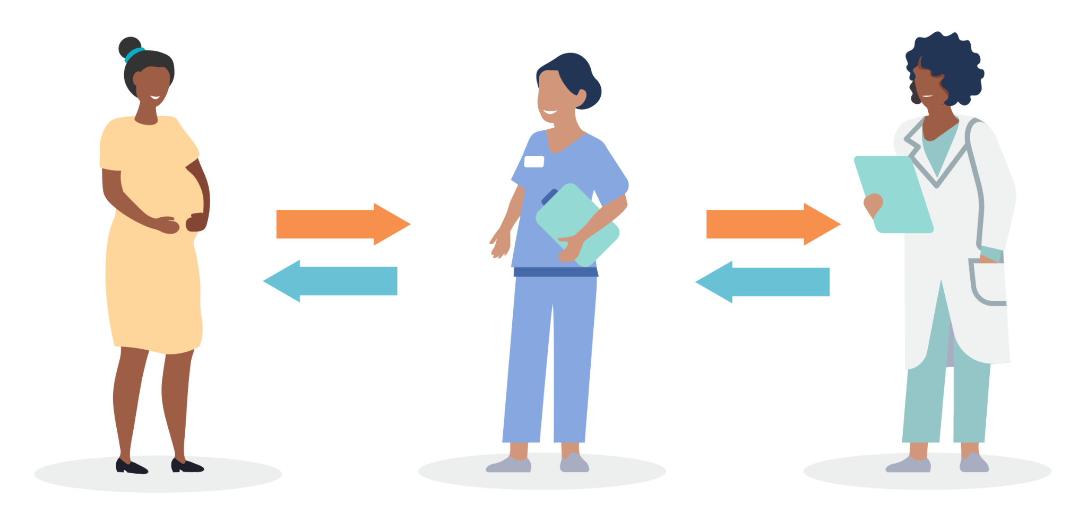
Current Communication
TeamBirth Communication
Notes:
(30 secs)
Current communication in health care often involves the patient/birthing person relaying something to their nurse, and the nurse then goes to the hallway or nurse’s station to speak with or call the provider – which could be the physician, midwife, or resident. And then goes back to the patient to share what the provider said. The nurse or resident often ends up playing telephone.
TeamBirth focuses on a team-based approach. What’s different with TeamBirth is that instead of the nurse, or resident, going into the hallway to call the provider, whether that’s the physician, midwife, etc., those conversations and decision making that traditionally happens outside the patient’s room -> now those conversations and that decision making is going to take place in the patient’s room, in front of the patient, with the patient.
This team-based approach helps break down the hierarchy we see in health care and reduces the chance for information to get miscommunicated or things to get missed.
TeamBirth focuses on creating shared plans with the birthing person as a key member of the team.

Slide 6
TeamBirth Core Components
Critical to successful delivery of TeamBirth across the maternal health continuum
1
STRUCTURED TEAM HUDDLES
2
SHARED PLANNING TOOL
Structured conversations that includes the birthing person and their support people
Visual tool that structures communication and provides space to document discussions during huddles
Notes:
(60 secs)
This graphic is a visual representation of TeamBirth.
Changing behaviors and culture in the way we deliver care can be hard but, at its core, TeamBirth is simple. It consists of two Core Components:
1. STRUCTURED TEAM HUDDLES that include all members of the team including the patient and support person
2. And the SHARED PLANNING TOOL (or whiteboard) which is the visual guide for structuring and documenting the huddle conversation

Slide 7
TeamBirth Huddles:
WHO
WHEN
The entire direct care team, including the person in labor and their support
At admission and at major decision points or changes in care plans throughout labor and postpartum
WHAT
WHY
Discuss preferences; care plans for mom, baby, and labor progress*; and expectations for the next huddle
Give all team members the opportunity to participate in shared decision-making
* ‘Labor progress’ refers to the laboring uterus and cervix. Plans for progress should also be discussed in postpartum and newborn huddles.
Notes:
(60 secs)
The basics of TeamBirth are summarized here:
●For WHO, the entire care team which includes the person in labor and their support persons. TeamBirth huddles should include, at a minimum, the person giving birth, their nurse, and a provider (and can include others on the care team as applicable, such as the midwife, resident, etc.),
●WHEN, gathering at admission and any major decision points or changes throughout labor and postpartum,
●WHAT, to discuss preferences, the care plans for mom, baby and labor progress, as well as expectations for the next huddle,
●And WHY, in order to ensure all team members have the opportunity to participate in shared decision-making

Slide 8
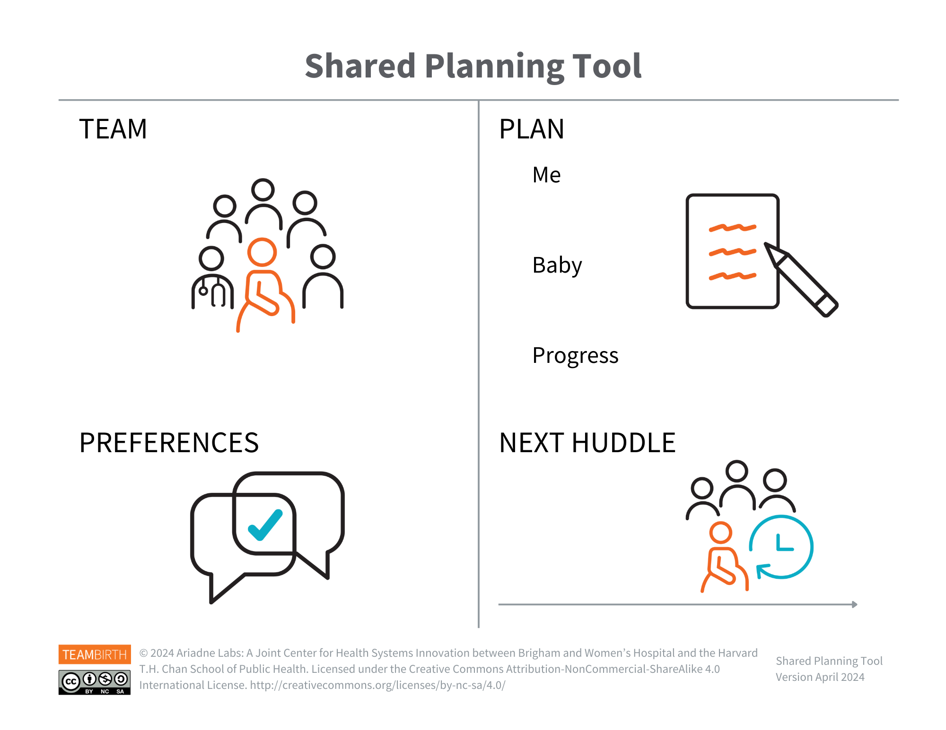
TeamBirth’s components promote four key behaviors:
Promoting the role of each team member
Eliciting patient preferences
Distinguishing plan for patient, baby, and labor progress*
Set shared expectations for the timing of the next huddle
Notes:
(60 secs)
The TeamBirth solution embodies two design principles: teamwork, to promote psychological safety and shared decision making, and simplicity, to reliably communicate information across the full care team.
The purpose of the shared planning board is to visually and consistently remind the team of four key behaviors. These behaviors ensure that in every huddle we:
Promote the role of each team member: as simple as identifying and writing the names of everyone on the team, starting with the person giving birth. This is a huge step in providing psychological safety and giving everyone room to speak up;
Elicit patient preferences: which encourages the person giving birth to share their preferences, concerns, and questions in this moment;
Distinguish the care plan for the patient, baby, and labor progress: which is what you do all the time but it’s putting it in a standard format that is easy for the person giving birth to understand how things are going for them, baby, and their labor
And set shared expectations for the timing of the next huddle
These behaviors ensure psychological safety, help support equitable care, create space for shared decision-making, and ensure transparency for next steps.
The bulk of today’s session is focused on practicing huddles. We want you to get comfortable with each of these key behaviors and using the shared planning board to document the discussion in patient friendly language.

Slide 9
WHEN TO HUDDLE
Notes:
(10 secs)
A common question about Huddles, and a core piece of TeamBirth, is when Huddles happen.

Slide 10
Door to Door TeamBirth
TeamBirth sets the standard for team communication throughout every birthing journey.
TeamBirth will look different based on:
Your specific unit structure
Your patient’s unique preferences and medical needs
Triage / OBED
Discharge
Notes:
(30 secs)
Ideally TeamBirth is the standard for communication throughout the entire patient journey from door to door, admission to discharge.
However, we know this journey will need to be customized so that TeamBirth works seamlessly on our unit and based on our patients’ preferences and medical needs.

Slide 11
When to Huddle Key Moments
These key moments describe how TeamBirth is put in practice throughout the birthing journey.
Labor
Triage / OBED
Ensure patient needs are addressed and support labor progress with PLANNED and AS NEEDED huddles
Postpartum
Discharge
If transferring, establish the new mom baby board and huddle as needed for changes to the care plan
Birth
Huddle to discuss about deciding to do an assisted delivery or c-section
Admission
Around admission, ensure an INITIAL huddle occurs that establishes TeamBirth as the standard process for communication
Newborn
Huddle with newborn providers or lactation to address changes to the newborn plan of care
Notes:
(120 secs)
*animation* 5 clicks for each of the key moments
Throughout childbirth, there are key moments when it is essential to have a TeamBirth huddle. The key moments I will highlight in just a minute are core to TeamBirth, even though how and when they happen may vary.
Each key moment describes how a TeamBirth huddle is put into practice throughout the birth journey. Core to TeamBirth are:
(click) The INITIAL huddle which occurs at or around admission and introduces TeamBirth as the process for team communication.
(click) During labor, there are often PLANNED and AS NEEDED huddles which ensure patient’s needs are addressed and the care plan is updated to support labor progress.
(click) When it is time for delivery, there are huddles to discuss decisions about an assisted delivery or c-section and potentially a huddle to debrief after delivery
(click) In postpartum, huddles can support unit transfers and/or facilitate changes to mom and baby’s plan of care until discharge.
(click) and finally there are newborn specific huddles when changes to newborn care are needed.
We will talk about and practice what huddling in these key moments can look like.

Slide 12
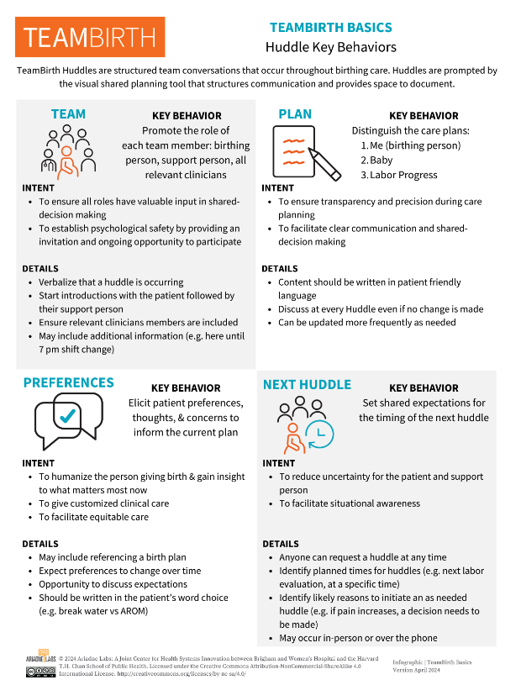
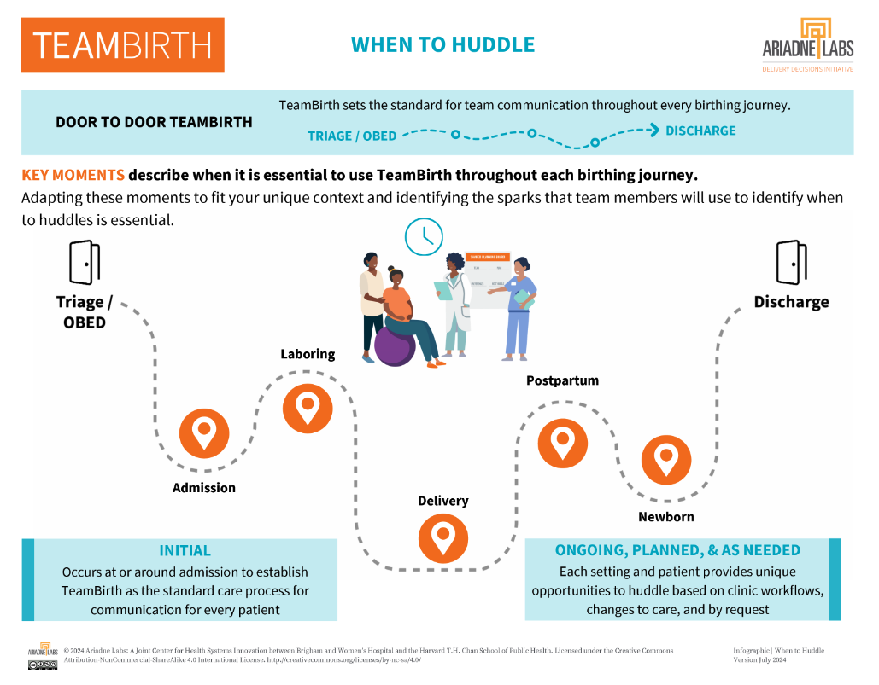
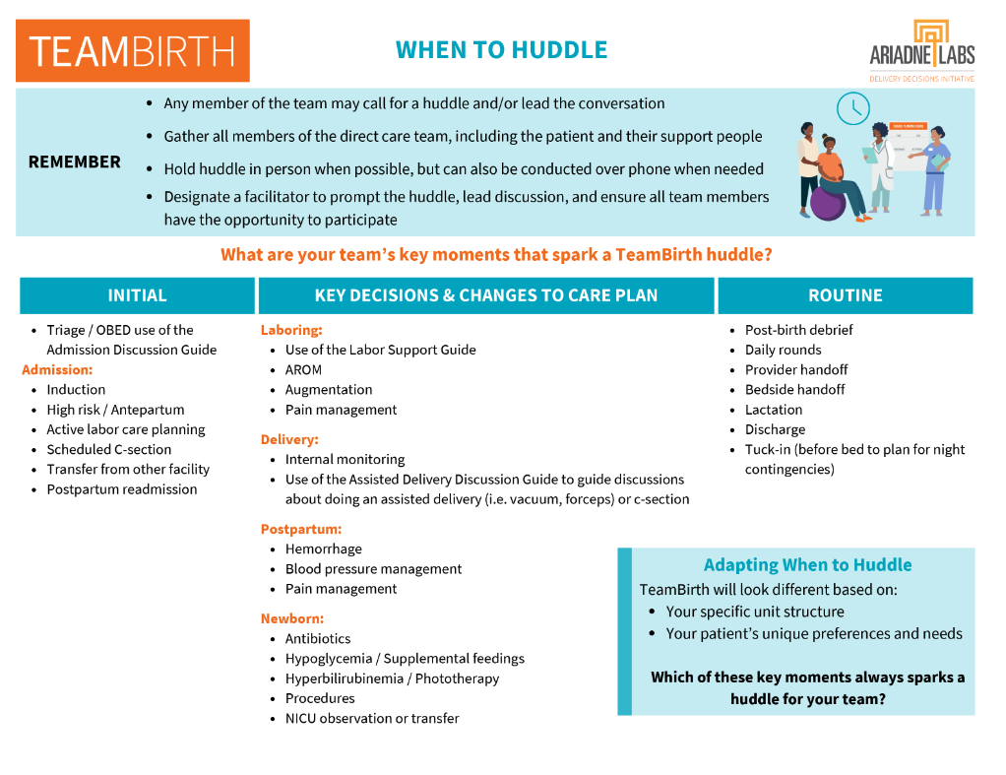
Resource Spotlight
TeamBirth Basics 1-pager | When To Huddle 2-pager
Notes:
(30 secs)
*Have these printed as handouts for the session. It can be helpful to keep a TeamBirth resource binder at the nurse’s station or have these individual pages there. Be sure to let staff know where they can find them.*
The TeamBirth Basics resource is a 1-pager that reviews the definition, purpose, and details we’ve talked about for each TeamBirth key behavior.
The When to huddle resource is a 2-pager that reminds you of the key moments when a teambirth huddle is valuable and a list of example sparks, or times, when huddles can happen, depending on the patient’s situation.

Slide 13
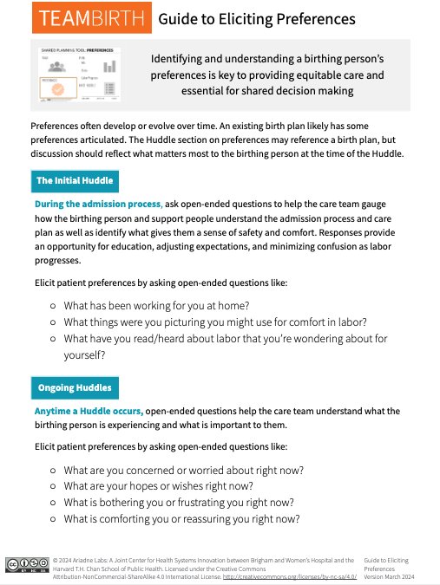
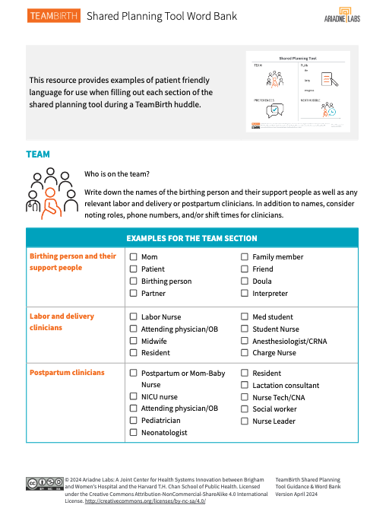
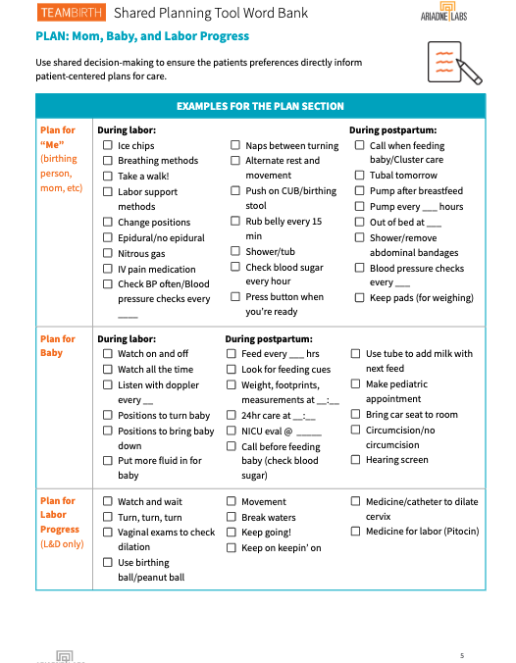
Resource Spotlight
Guide to Eliciting Preferences 1-pager | Spanish & English Board Word Banks
Notes:
(60 secs)
*Have these printed as handouts for the session. It can be helpful to keep a TeamBirth resource binder at the nurse’s station or have these individual pages there. Be sure to let staff know where they can find them.*
The Guide to Eliciting Preferences resource is a 1-pager for common open-ended questions used to engage patients in initial and ongoing huddles.
And the Shared Planning Tool Word Banks provide common phrases in patient-friendly language you can use in each section of the board to communicate frequently discussed topics in both English and Spanish.

Slide 14
TeamBirth Key Behaviors
Learning and applying TeamBirth with the shared planning board
Notes:
Now we will go into more detail about each of the 4 key behaviors and what it looks like to start applying them in practice

Slide 15
Sparking a Huddle
Each huddle starts with a spark which is anyone identifying the need for a huddle.
There are many different reasons to huddle, but a huddle will never happen unless someone identifies the spark.
Triage / OBED
Discharge
Admission
Notes:
*Note, animation highlights admission huddle opportunity. This slide can be updated to reflect whenever your scenario is happening, like changing this to a postpartum huddle.*
As we mentioned, identifying when to spark, or start, a huddle is the first step. We will demonstrate the initiation of an admission huddle in today’s session.

Slide 16
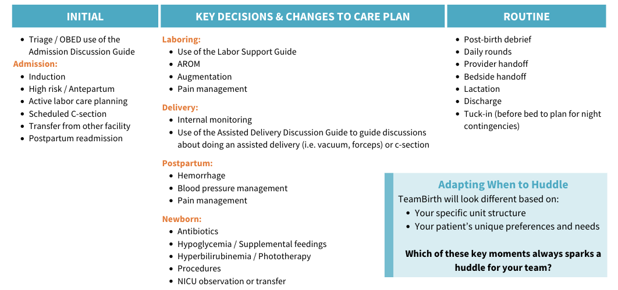
When to Huddle
What are your team’s key moments that spark a TeamBirth huddle?
Notes:
It helps to think through when to huddle on a big scale, so we have a good idea of when a “next huddle” could occur. For reference these are the options in the “when to huddle” handout.
As you can see on the left there are many different sparks that may lead to an initial admission huddle and it can happen first thing in triage or later once the admission has begun

Slide 17
TEAMBIRTH Introduction
Ensure the patient knows what TeamBirth is
Admission Huddles should be used to establish TeamBirth huddles as the communication process the patient will experience throughout their time at the hospital
Anytime a huddle begins confirm the patient is familiar with TeamBirth and provide any explanation so they understand what is happening and why
Key Points
TeamBirth ensures teamwork and consistent transparent communication
This process is used for all birthing patients
The purpose is to ensure you [the patient and support person] can share your preferences and needs and be a part of decision making for your care.
Notes:
*Read slide.

Slide 18
Notes:
Once we have identified the need for a huddle, the huddle begins with the Team section

Slide 19
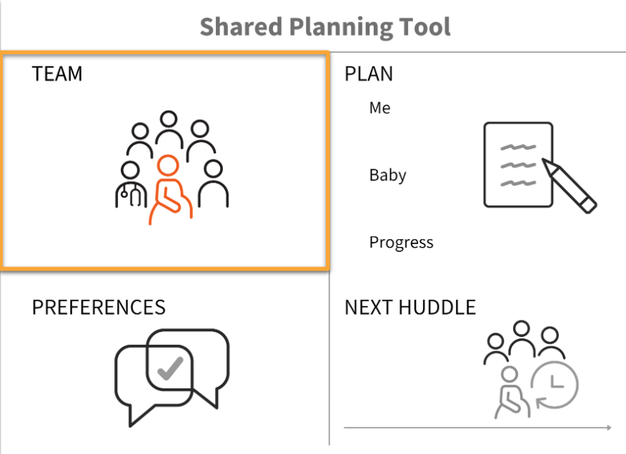
TEAM
KEY BEHAVIOR: Promote the role of each team member
INTENT | To ensure all roles have input in shared-decision making To establish psychological safety by providing an invitation and ongoing opportunity to participate | DETAILS | Verbalize that a TeamBirth huddle is occurring Start with the patient followed by their support people Ensure relevant team members are included
Notes:
*read slide*

Slide 20
Who is on the Team
The direct care team includes any support people accompanying the patient as well as the clinical team primarily responsible for patient care
Birthing Person
Clinicians
Nurse Certified Nurse Midwife Physician (OB hospitalist, Attending OB, Resident) Lactation Consultant Anesthesiologist/CRNA Newborn Provider (Pediatrician, Nurse Practitioner, Resident)
Support Person
Partner / Spouse Family Friend Doula
Additional team members: Interpreter Social Worker Community-based Midwife
Notes:
*Read slide. Animation adds additional team members section.*

Slide 21
Psychological Safety
Including and introducing each team member sets up psychological safety
The TEAM section and key behavior facilitate:
An environment that allows individuals to feel safe, comfortable, and supported in expressing themselves
Mitigation of fear of negative consequences such as judgement, criticism, or punishment
Minimizing hierarchical power dynamics inherent in healthcare
Your ideas and experience matter, regardless of title, position, or education
We encourage safe communication and creating opportunities to speak up
Notes:
The Team key behavior promotes psychological safety by including and introducing each person included in the conversation about care planning.
This inclusion and introductions help facilitate:
An environment that allows individuals to feel safe, comfortable, and supported
Reduces fear of negative consequences such as judgement, criticism, or punishment
Reduces hierarchical power dynamics inherent in healthcare
The goal is to make every patient and other team members like support people, nurses, doulas, or residents feel that their ideas and experience matter regardless of their title

Slide 22
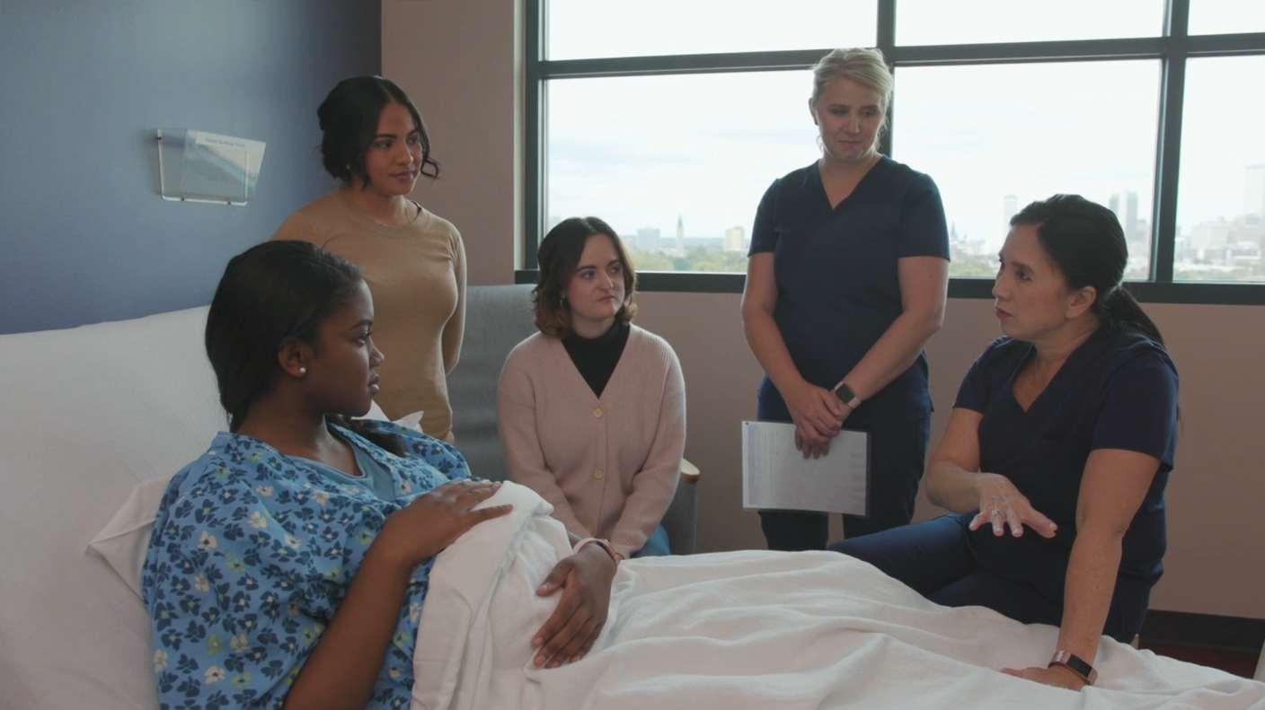
Huddle Spark
DEMO - SCENARIO 1
Alea is being admitted to the hospital at 5cm for active labor.
Alea’s care team is having an initial huddle upon admission to the hospital.
Notes:
We will do brief bite sized huddle scenarios to demonstrate each of the key behaviors and boards sections in action.
This scenario begins with the admitting nurse identifying an opportunity to huddle for Alea who is being admitted for active labor at 5 cm.

Slide 23
Team
DEMO - SCENARIO 1
Christine
Doula
Trisha
Nurse
Sarah
Best Friend
Alea
Patient
Dr. Chien
OB/GYN
Notes:
*DEMO SCRIPT – fill in names for roles (Or see the Training Scenarios resource for this scenario script (on page 2) and other scenarios.) Feel free to make any edits or change names.*
Nurse (ADELISA): (Writing on whiteboard throughout - although in reality, you can encourage a patient’s support person, if present, to write on the board) Alea, as we get you admitted we are going to bring in Dr. Chien for an initial TeamBirth huddle so that we can talk about what is important to you and together create a care plan for you and your baby. We use TeamBirth huddles to communicate and work as a team throughout your stay at the hospital. Huddles will bring the care team together, including you and any support people you want included, so we can discuss what is happening, answer any questions, and together ensure any decisions are made with your preferences in mind. How does that sound?
Patient Alea (ANNELISE): Sounds ok
OB (ADELISA): Hello everyone, Alea it is so nice to meet you, I am Dr. Chien, the OB who will be caring for you this evening. We always start our huddles by ensuring everyone who needs to be a part of the team is here. I know you’ve already met Trisha, but can you introduce who you have with you today?
Patient Alea (ANNELISE): Hi Dr. Chien, this is my doula Christine and my best friend Sarah will be coming back soon after she gets dinner.
OB (ADELISA): So nice to meet you Christine, and if Sarah comes back you are welcome to include her in huddles if that is what you’d like.
Patient Alea (ANNELISE): Yes, I’d really like her to be here when she’s able.

Slide 24
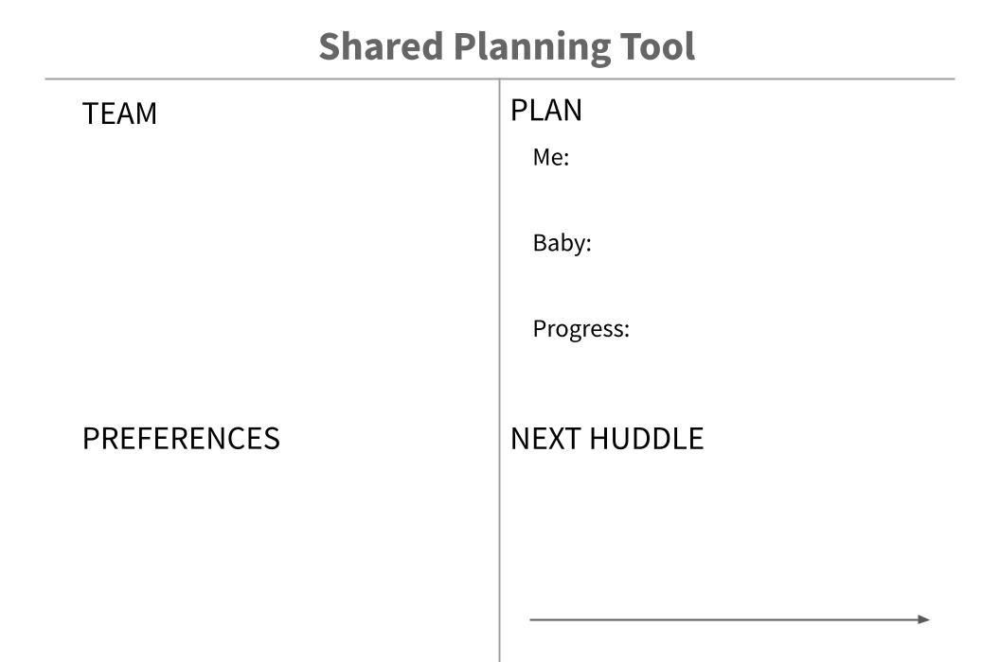
TEAM
Other information may be valuable to include during introductions of the team
In addition to names you may include:
Role or Title
Shift times
Relationship to birthing person
Accessibility needs
Alea
Sarah - friend (Spanish)
Christine - doula
Trisha - RN (here til 7pm)
Dr Chien - OB (here til 7am)
Notes:
For reference, this may be what the board could look like after this initial introduction. Notice that other details may be valuable to include like people’s role or title, shift information, and language or accessibility needs.

Slide 25
SPARK & TEAM
SCENARIO 1 - HUDDLE 1
PRACTICE
Take 2 mins and write out what you might say to introduce TeamBirth to Alea
Share your statement in the chat or come off mute to demonstrate it for us!
Alea
Sarah - friend (Spanish)
Christine - doula
Trisha - RN (here til 7pm)
Dr Chien - OB (here til 7am)
Scenario
Alea is being admitted to the hospital at 5 cm for active labor. Alea’s care team is having an initial huddle upon admission to the hospital.
Key Points
TeamBirth ensures teamwork and consistent clear communication
This is used for all patients
The purpose is to ensure you [the patient and support person] can share your preferences and needs and be a part of decision making for your care.
Notes:
Now it’s time for you all to start practicing. We’ll start with a brief bite sized practice that focuses on the TeamBirth huddle introduction.
You just heard how the nurse introduced this huddle but how would you say it to your patients. Turn to your neighbor and take a minute or two and say what you might say to a patient having their first huddle.
And remember to include the key points!
* If in person: Change the instructions to “1)Turn to a neighbor (pairs of 2-3) 2) For 2 mins each, practice your TeamBirth huddle introductions”, and use a timer or clock to track 2 minutes and then tell everyone to switch to the other partner if they haven’t already.

Slide 26
Notes:
After initiating the huddle and introducing the team, the conversation moves to the preference section.

Slide 27
PREFERENCES
KEY BEHAVIOR: Elicit patient preferences, thoughts, & concerns to inform the current plan
INTENT | To humanize the person giving birth & gain insight to what matters most now To give customized care To facilitate equitable care | DETAILS | May include referencing an already established birth plan Expect these to change over time Opportunities to discuss expectations Encourage support people to help write in this section Should be written in the patient’s word choice (ie. break water vs AROM)
Notes:
The preferences section creates the intentional space to elicit patient preferences, thoughts, & concerns which are used to inform the current plan.
The preferences and plan sections are closely related and we’ll talk a lot more about what they look like in action.
The intent behind this section is to ensure the team is humanizing the patient and really understanding what matters most to them in the moment of the huddle. By hearing about what matters to them now, the team can customize their care which facilitates equity.
Some key details to keep in mind as we talk about the preferences section are how it relates to a potentially established birth plan (we’ll talk more about that in the Plan section of the board), that this section is expected to change over time from huddle to huddle, that this section is a key opportunity to discuss expectations and answer questions, that it is a good time to engage the support person in writing on the board, and that the board should be written in ways that are easily understood by the patient.

Slide 28
Equitable Care
The concept facilitated via the PREFERENCES section and key behavior
Birth equity refers to the principle and goal of ensuring that every individual, regardless of their background or circumstances, has access to safe, respectful, and high-quality maternity care throughout the childbirth process
It emphasizes addressing and eliminating disparities, inequities, and systemic barriers that contribute to unequal birth outcomes and experiences among different populations.
Notes:
*read slide*

Slide 29
Eliciting Preferences
Talking through preferences is a key component to providing safe, dignified care.
Open-ended questions asked during a huddle, elicit preferences
These questions can help clinicians:
Identify what gives the patient a sense of safety and comfort
Gauge how the plan is being understood by everyone on the care team
The answers can help clinicians identify opportunities to:
Provide education
Adjust expectations
Minimize conflict or confusion
Notes:
When opening up the conversation for the preferences section, we use open-ended questions which help the clinical team to:
Identify what gives the patient a sense of safety and comfort
Gauge how the current plan is being understood by everyone on the care team
How patients respond to well-chosen open-ended questions will highlight opportunities to provide education, discuss and adjust expectations as well as minimize confusion or conflict

Slide 30
Knowledge Checks
True or False and discuss
The preference section is a place to transcribe a patient’s birth plan so everyone can see it.
During the admission huddle, best practice is to ask a patient “Do you have any preferences?” so that you do not have to ask again on any additional huddles.
The preference section is a visual cue to elicit what is most important to the patient during the current huddle, to hear concerns and thoughts about current options and choices.
The preference section can also be used to remind us to check in with others on the team (partners, doulas, other clinical team members).
The preference section is a place to transcribe a patient’s birth plan so everyone can see it.
During the admission huddle, best practice is to ask a patient “Do you have any preferences?” so that you do not have to ask again on any additional huddles.
The preference section is a visual cue to elicit what is most important to the patient during the current huddle, to hear concerns and thoughts about current options and choices.
The preference section can also be used to remind us to check in with others on the team (partners, doulas, other clinical team members).
Notes:
*These example knowledge check questions can be used primarily to stimulate discussion and questions rather than testing folks on what they know. You may choose to separate these out on individual slides or make a fun interactive game for folks to share their answers with them.
This first question is FALSE with the highlighted words showing a chance to discuss how a patient’s birth plan can be used to inform the preferences section of any individual huddle, but the goal of huddles is to identify what matters most to a patient in the moment of the huddle.
The second question is FALSE with the highlighted words showing that the inclusion of every section of the board in every huddle is necessary because we know that preferences can change throughout labor.
The last two questions are TRUE*

Slide 31
PREFERENCES
DEMO - SCENARIO 1
Alea’s care team is having a huddle and discussing her preferences upon admission to the hospital.
She is 5 cm and in active labor.
Notes:
To demonstrate the preferences section of the huddle, we’ll return to our scenario where Alea’s care team is having a huddle and discussing her preferences upon admission to the hospital.
*DEMO SCRIPT (Or see the Training Scenarios resource for this scenario script (on page 2) and other scenarios.) Feel free to make any edits or change names.*
OB (ADELISA): As we get started planning your care, what preferences do you have?
*pause*
Patient Alea (ANNELISE): um… I’m not sure, no one has really asked me that before. Did I need to have a birth plan?
Nurse (ADELISA): (Writing on white board throughout) Oh that is ok, we just want to better understand what is important to you now and as you think about the experience you want to have during your labor and delivery. Is there anything that you are worried about right now?
Patient Alea (ANNELISE): Oh, well I really don’t want to be stuck in bed and I heard in my childbirth class that you all have tubs and exercise balls to use?
OB (ADELISA): Yes that is great to know, we definitely want to support your movement and can talk about how and when using a tub or ball can be helpful. What other things are you hoping for?
Patient Alea (ANNELISE): Well I’m worried about having lots of lights or noise and I don’t want to have an IV.
OB (ADELISA): Thank you for sharing those preferences with us Alea. There is a lot we can do to keep the room as quiet and calm as possible. Could you tell me a little more about why you don’t want an IV?
Patient Alea (ANNELISE): Well, like I said I really don’t want to be stuck in bed and I’d like to be able to walk around and get up whenever I need to. I really don’t want to be tied to a machine.

Slide 32
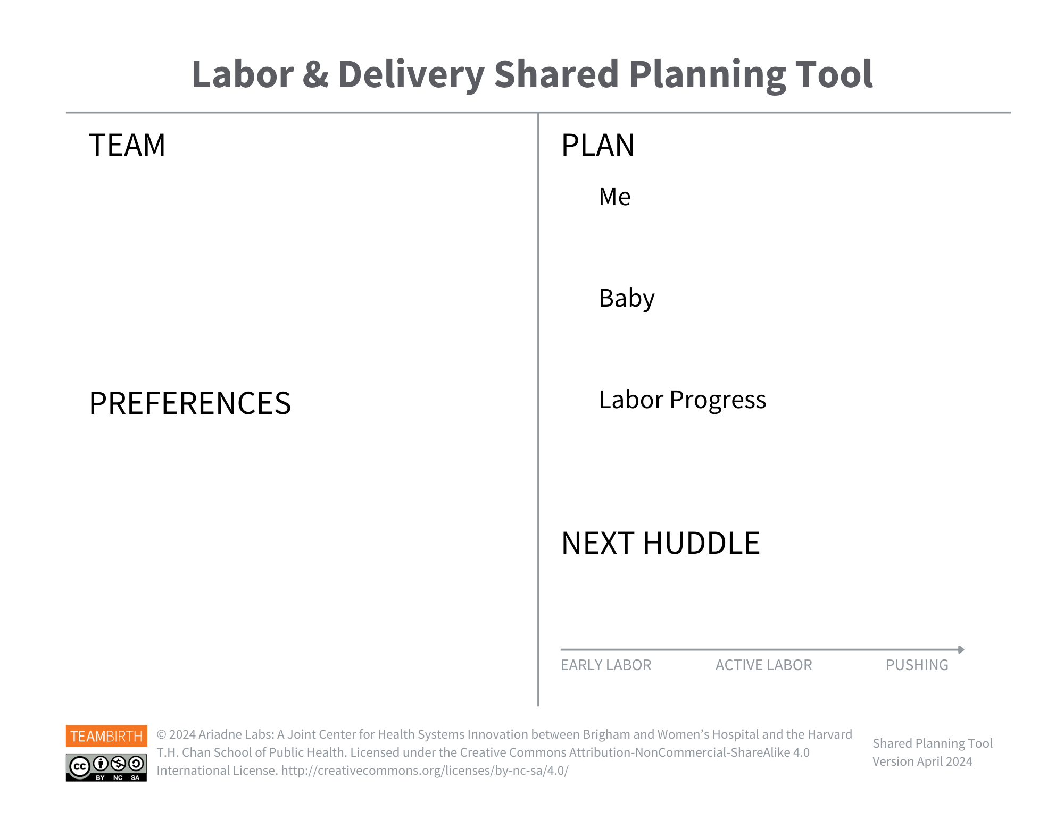
PREFERENCES
How would the team document Alea’s preferences using the shared planning tool?
Alea
Sarah - friend (Spanish)
Christine - doula
Trisha - RN (here til 7pm)
Dr Chien - OB (here til 7am)
move around - no IV
ball & tub
low lights & quiet voices
Notes:
Before we start talking about what to do with Alea’s preferences, let’s look at what we might write on the board based on what Alea shared with us.

Slide 33
PREFERENCES
SCENARIO 1 - HUDDLE 1
PRACTICE
Turn to a neighbor (pairs of 2-3)
Practice asking each other open ended questions that elicit patient preferences
Alea
Sarah - friend (Spanish)
Christine - doula
Trisha - RN (here til 7pm)
Dr Chien - OB (here til 7am)
Scenario
Alea’s care team is having a huddle and discussing her preferences upon admission to the hospital. She is 5 cm and in active labor.
EXAMPLES
What are you concerned or worried about right now?
What are your hopes or wishes right now?
What is bothering you or frustrating you right now?
What is comforting you or reassuring you right now?
move around - no IV
ball
low lights & quiet voices
Notes:
*Animation. Show example questions.*
Now we’ll do another brief practice that focuses on asking open-ended questions.
Turn to your neighbor and take a minute or two to share examples of open-ended questions that could help understand a patient's preferences. One of you could even respond as a patient and practice asking a series of open-ended questions that help better understand the patient’s needs.
*Use a timer or clock to track 2 minutes and then tell everyone to switch to the other partner if they haven’t already. If you haven’t already, show the examples to help people find inspiration/support*

Slide 34
CONNECTION: PREFERENCES AND PLANS
Patient preferences discovered in the Preferences section of the Huddle directly inform what is prioritized in the Plan section.
Elicit patient preferences that inform care planning
Distinguish the different care plans for the birthing person, baby, and labor progress
Notes:
There is a vital connection between the patient preferences the team discovered during the preferences section of the huddle and how they directly apply to the plan section.
The preference and the plan components of the huddle should inform each other. Getting comfortable with the relationship between the two can take some time and practice.
So it is very beneficial for the entire team to understand that preferences and plan go hand in hand.

Slide 35
Notes:
The plan section of the huddle and board intentionally distinguishes the different care plans for the birthing person, the baby, and labor progress.

Slide 36
ME
BABY
Distinguish the different
care plans
LABOR
PROGRESS
ME
BABY
Notes:
The key behavior of distinguishing these care plans helps to untangle the gray areas before, during, and after labor.
The board is intentionally designed to include sections where the plan for mother, the plan for baby, and the plan for progress is articulated. And in postpartum it continues to be valuable to differentiate plans of care between mother and the newborn.

Slide 37
PLAN
KEY BEHAVIOR: Distinguish the different care plans
INTENT | To ensure transparency and precision during care planning To facilitate clear communication and shared-decision making | DETAILS | Plan content should be written in patient friendly language Each Huddle, the Plan should be discussed even if no change is made Can be updated more frequently as needed by the nurse
Notes:
This part of the huddle ensures transparency with the patient and support person during care planning. This is when shared decision-making is put to use.
The plan is written on the board in patient friendly rather than clinical language, and the team makes a point to discuss the plan in every huddle even if there are not changes made to it. The board section should be updated as often as necessary so it is a single source for the patient to understand what is currently happening.

Slide 38
PLAN
DEMO - SCENARIO 1
Alea’s care team is having a huddle and discussing her preferences upon admission to the hospital.
She is 5 cm and in active labor
Alea wants to be walking, moving and out of bed as much as possible
She is interested in the tub and birthing ball
Alea also prefers low lights, quiet voices, and decreased stimulation
Alea stated not wanting an IV
Notes:
To demonstrate this, we’ll return to our scenario where Alea’s care team is having an admission huddle.
*DEMO SCRIPT (Or see the Training Scenarios resource for this scenario script (on page 2) and other scenarios.) Feel free to make any edits or change names.*
Patient Alea (ANNELISE): Well, like I said I really don’t want to be stuck in bed and I’d like to be able to walk around and get up whenever I need to. I really don’t want to be tied to a machine.
OB (ADELISA): That makes a ton of sense. We want to make sure the plan we create for you, your baby, and your labor meet your wishes as much as possible. Next we want to talk about that plan of care. It is helpful to think about differentiating the plans we make based on what they focus on. It sounds like it makes sense for us to currently plan for you to be up moving around as much as possible so you are welcome to walk around the room or halls.
Nurse (ADELISA): (Updating preference section and plan section in real time) And we can also plan to take your vitals sitting in a chair instead of you having to get back into bed.
OB (ADELISA): It is our hospital policy to have at a minimum an IV that is saline locked to ensure we can respond quickly to any need you or baby have. Since you do not need any IV fluids, if we keep the IV unhooked so that you can still get up and move around, does that sound ok?
Patient Alea (ANNELISE): Ok that makes sense. Yes I’m ok with that.
OB (ADELISA): As we think about baby’s plan we will need to monitor baby’s heart 20 mins every hour - which we can for now do between your walks. The plan for labor progress is to continue moving around and we can plan to set up the tub for you whenever you're ready.
Doula (ADELISA): Are you interested in the tub soon?
Patient Alea (ANNELISE): I’m ok waiting until things get more painful.
Nurse (ADELISA): Sounds good. Are there any questions you have about this plan or other things you want us to know?
Patient Alea (ANNELISE): Nope thank you, this makes sense

Slide 39
PLAN
How would the team document Alea’s plan using the shared planning tool?
Walk in room
Chair for BPs
No IV fluids yet
Alea
Sarah - friend (Spanish)
Christine - doula
Trisha - RN (here til 7pm)
Dr chien - OB (here til 7am)
Listen to baby’s heart rate between walks
Keep Moving! Hold off on tub
move around - keep IV unhooked
ball & tub
low lights & quiet voices
Notes:
This may be what is written on the board based on the care planning discussion during the huddle.
We often get questions around, How do my assessments fit into the shared planning board & huddles?
We know that clinicians are experts at quickly and routinely assessing their patients, and clinical assessments are critical to providing up to date medical information that informs the PLAN.
But they are not explicitly included on the board because: Clinicians don’t need a reminder to do or talk about their assessments and clinical assessments are documented in the EHR.
Now, before we practice today, we’ll discuss the fourth key behavior and then put our learning to work with a final scenario.

Slide 40
Notes:
The last section of the board concludes the huddle by looking ahead to the next one.

Slide 41
NEXT HUDDLE
KEY BEHAVIOR: Set shared expectations for the timing of the next huddle
INTENT | To reduce uncertainty for the person giving birth and support person To facilitate situational awareness | DETAILS | Identify planned times for huddles (e.g. next labor evaluation, in a specific time frame) Identify likely reasons to initiate an as needed huddle (e.g. if pain increases, a decision needs to be made) Anyone can request a huddle They can occur in-person or over the phone/video conference
Notes:
The Next Huddle section helps set shared expectations for the timing of the next huddle.
This intends to reduce uncertainty and facilitate situational awareness.
We don’t recommend setting a specific time for the next huddle, but sometimes it makes sense to include a time range. Like if everyone agrees the longest we can go is 3 hours before another assessment/plan update can occur, we might say “in 2-3 hours” or “around a specific time”. We know that providers don’t typically want to be held to a set time for meeting.
Commonly next huddles are said to happen with anticipated events that will spark a huddle. For example, if you know you’ll need to wait for baby’s labs to come back before making the next decision,your next huddle may indicate “when baby’s labs are back.”
We also always want to remind the patient that huddles can happen by request or at any time as needed even if they happen over the phone rather than in person.

Slide 42
NEXT HUDDLE
DEMO - SCENARIO 1
Notes:
To demonstrate this final section, we’ll return to our admission scenario with Alea’s care team.
*DEMO SCRIPT (Or see the Training Scenarios resource for this scenario script (on page 2) and other scenarios.) Feel free to make any edits or change names.*
Nurse (ADELISA): Are there any questions you have about this plan or other things you want us to know?
Patient Alea (Annelise): Nope thank you, this makes sense
OB (ADELISA): Good to hear. You’re doing really well so far Alea, and to ensure that we are clear what to expect moving forward, we’ll make a note on the board here that we will plan to huddle again when you feel the urge to push, probably in the next hour or so. At that time we’ll see how you are feeling and discuss next steps for delivery.
Nurse (ADELISA): Before then, if you, Alea, or Sarah or Christine have a concern you can request that we all come together for a huddle at anytime. Just call me and let me know what you need.

Slide 43
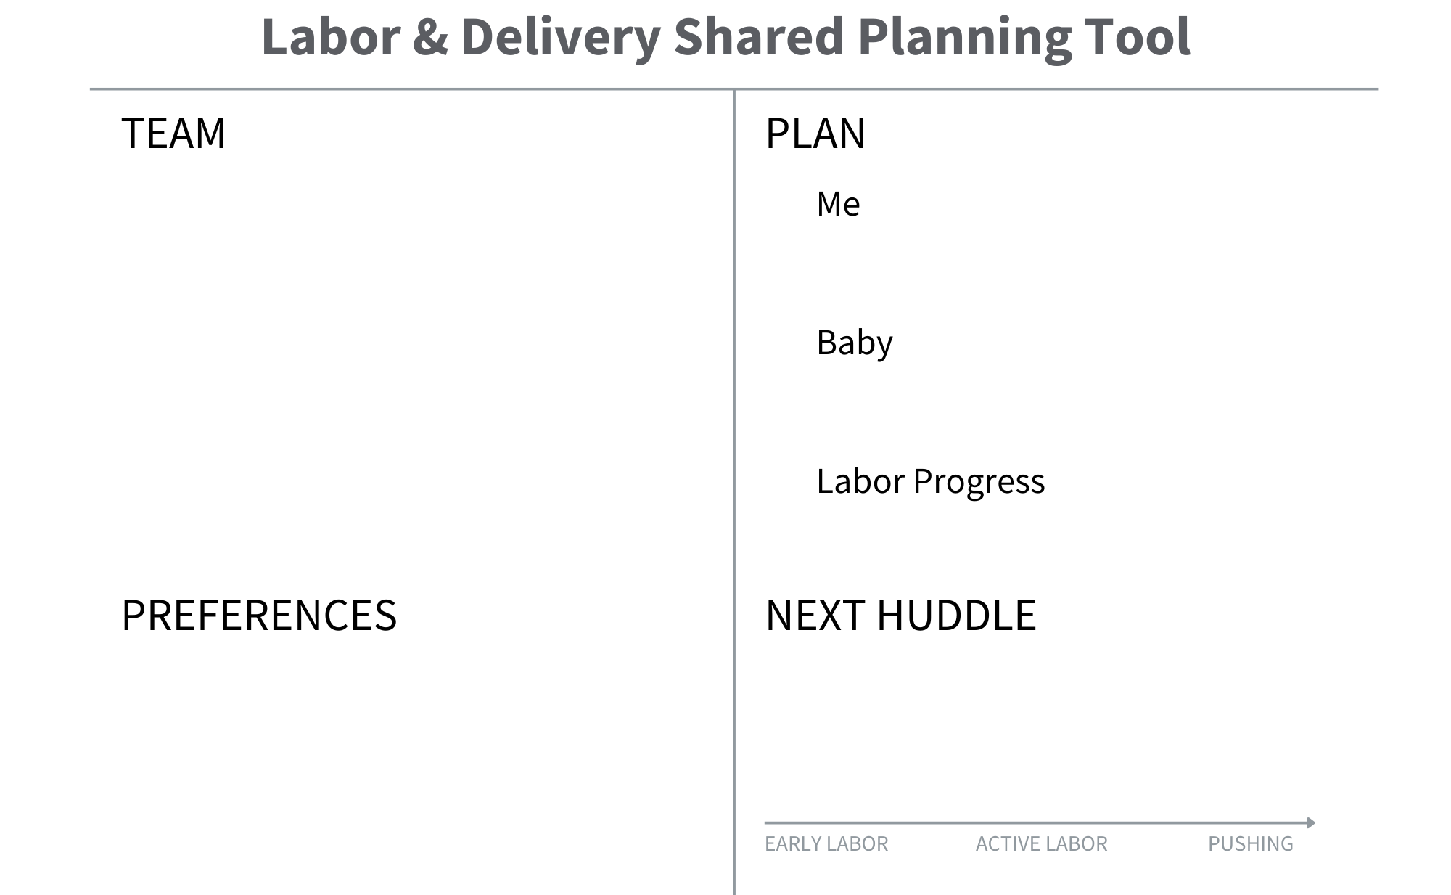
NEXT HUDDLE
How would the team document Alea’s next huddle using the shared planning tool?
Walk in room
Chair for BPs
No IV fluids yet
Alea
Sarah - Best Friend
Christine - Doula
Trisha - Nurse
Dr. Chien - OB/GYN
Listen to baby’s heart rate between walks
Keep Moving! Hold off on tub
move around - keep IV unhooked
ball & tub
low lights & quiet voices
When you feel the urge to push
(In ~1 hour )
Notes:
This may be what is written on the board based on the care planning discussion during the huddle.

Slide 44
Scenario 2: L&D Admission Huddle
Applying TeamBirth with the shared planning board
Notes:
*Update this scenario based on what makes sense for your teams. An L&D admission scenario (this slide, slide 45) and a postpartum scenario (see slide 54) are provided. Please edit or change these as needed.*
Now that you’ve seen each key behavior demonstrated, let’s practice putting it all together with a new scenario.

Slide 45
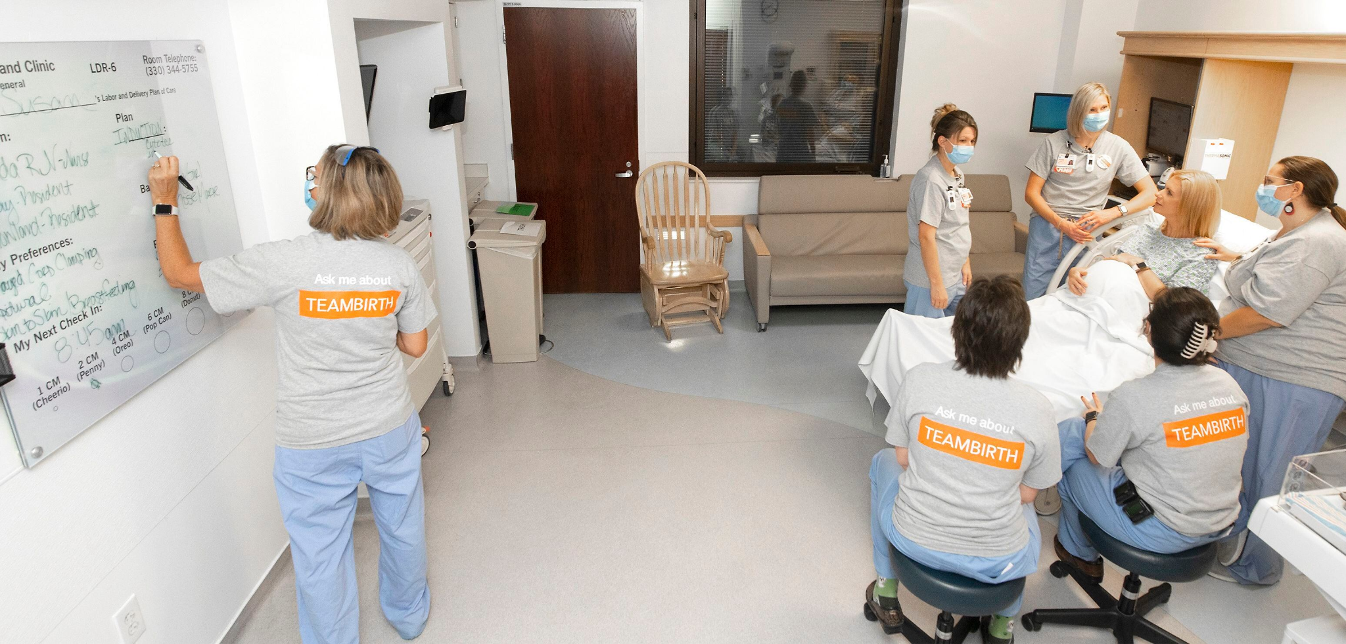
SPARK & TEAM
SCENARIO 2 - HUDDLE 1
Jade is being admitted to L&D in early labor. She is scheduled for a postdates induction tomorrow. She is having regular, painful contractions and worried about the baby since she’s overdue.
G1P0, 40.6 wks, low-risk pregnancy
FHR reassuring
Membranes intact
Cervix is 3/90%/-1
Cervix was fingertip at 40 week office appt
Contractions every 2-5 minutes in a coupling pattern. The long-lasting contractions are strong to palpation.
Jade’s provider is here for the admission huddle.
Notes:
*Read slide. You may want to print out the scenario details for people to reference in hand, see the Training Scenarios resource, Page 3: Scenario Prompt A - Jade.*

Slide 46
SPARK & TEAM
SCENARIO 2 - HUDDLE 1
PRACTICE
Turn to a neighbor (pairs of 2-3)
For 2 mins each, practice your TeamBirth huddle introductions and the Team section
Jade
Kyle - partner
Maria - RN
Amanda - Midwife
Dr. George - OB
Baby Simone
Dr. Williams - Peds
Key Points
TeamBirth ensures teamwork and consistent clear communication
This is used for all patients
The purpose is to ensure you [the patient and support person] can share your preferences and needs and be a part of decision making for your care.
Notes:
Now it’s time for you all to start practicing.
If this is your care team here on the board, turn to your neighbor and take a minute or two to say how you might introduce Jade’s first huddle.
And remember to include the key points!
*Use a timer or clock to track 2 minutes and then tell everyone to switch to the other partner if they haven’t already. After providing instruction, you may go back to the previous to show the scenario details again.*

Slide 47
PREFERENCES
SCENARIO 2 - HUDDLE 1
PRACTICE
Turn to a neighbor (pairs of 2-3)
What open ended questions would you ask to understand Jade’s preferences?
Jade
Kyle - partner
Maria - RN
Amanda - Midwife
Dr. George - OB
Baby Simone
Dr. Williams - Peds
EXAMPLES
What are you concerned or worried about right now?
What are your hopes or wishes right now?
What is bothering you or frustrating you right now?
What is comforting you or reassuring you right now?
Notes:
*Animation. Show example questions*
Now what open-ended questions would you ask Jade?
(Optional) Would someone like to volunteer to demonstrate as patient, nurse, and provider?
*Use a timer or clock to track 2 minutes and then tell everyone to switch to the other partner if they haven’t already. If you haven’t already, show the examples to help people find inspiration/support.*

Slide 48
PREFERENCES
SCENARIO 2 - HUDDLE 1
“I am running so hot! Gah, I really need that fan turned towards me at all times… I’m really hoping for a natural childbirth or at least to wait as long as possible for an epidural if possible so I can keep moving around.
And I am so freaked out about vacuum deliveries. My sister had one and it was awful so please avoid using a vacuum.
We want lots of photos including of the placenta afterwards, and Kyle is really looking forward to doing skin-to-skin!”
Notes:
Based on the conversation, Jade shares several statements about her preferences:
*Read slide. You may want to print out the scenario details for people to reference in hand, see the Training Scenarios resource, Page 3: Scenario Prompt A - Jade.*

Slide 49
PREFERENCES
SCENARIO 2 - HUDDLE 1
PRACTICE
Write* Jade’s preferences on you board.
*Asking support people to help write on the board is a great way to task share and ensure patient friendly language!
Jade
Kyle - partner
Maria - RN
Amanda - Midwife
Dr. George - OB
Baby Simone
Dr. Williams - Peds
epidural eventually, wait if possible
Lots of pictures
I’m so hot!
At birth:
No vacuum
Kyle wants skin to skin too
Placenta pics
Notes:
What would you all write on the board based on what Jade shared?
*You may go back to the previous to show the scenario details again and either have someone write on a whiteboard what people share, or just wait and click the animation to show the examples on the slide.*

Slide 50
PLAN
SCENARIO 2 - HUDDLE 1
PRACTICE
Discuss as a group what you all might discuss with Jade for her, baby Simone, and the labor plan based on her preferences.
Talk through the initial plan options for Jade and Simone
Practice discussing Jade’s preferences as you determine each plan
Jade
Kyle - partner
Maria - RN
Amanda - Midwife
Dr. George - OB
Baby Simone
Dr. Williams - Peds
Keep fan close
Keep cool (ice and wet cloths)
Listen to baby on and off
epidural eventually, wait if possible
Lots of pictures
I’m so hot!
At birth:
No vacuum
Kyle wants skin to skin too
Placenta pics
Keep moving!
Ball, stand and sway
Notes:
Now that we’ve heard from Jade, what might we include in the care plan for her, for baby, and for labor progress?
What are your ideas and how might you right them in patient friendly language?
*You may instruct people to talk in small groups or have a discussion with everyone together. You may go back to the previous to show the scenario details again and either have someone write on a whiteboard what people share, or just wait and click the animation to show the examples on this slide.*

Slide 51
NEXT HUDDLE
SCENARIO 2 - HUDDLE 1
PRACTICE
Turn to a neighbor (pairs of 2-3)
Tell each other what to expect for when the next huddle could happen
Jade
Kyle - partner
Maria - RN
Amanda - Midwife
Dr. George - OB
Baby Simone
Dr. Williams - Peds
Keep fan close
Keep cool (ice and wet cloths)
Listen to baby on and off
epidural eventually, wait if possible
Lots of pictures
I’m so hot!
At birth:
No vacuum
Kyle wants skin to skin too
Placenta pics
Keep moving!
Ball, stand and sway
After next exam (in a couple hours)
By request
EXAMPLES
As needed
Per request by anyone on the team
Notes:
And finally, how would you conclude Jade’s huddle? When could the next huddle occur?
*You may instruct people to talk in small groups or have a discussion with everyone together. Animation to show the examples. Either have someone write on a whiteboard what people share, or just wait and click the animation to show the next huddle example on this slide.*

Slide 52
Jade
Baby Simone
Kyle - partner
Dr. Williams- Peds
Dr. George- OB
Keep fan close
Keep cool (ice and wet cloths)
Amanda- Midwife
Maria- RN
Listen to baby on and off
I’m so hot! Lots of photos!
Labor - Keep moving!
Ball, stand and sway
epidural eventually, wait if possible
At birth- No vacuum
After next exam (in a couple hours)
By request
Kyle wants skin to skin too
Notes:
*Use this slide to include an example of the scenario written on your site specific shared planning board.*
In other words, change out this photo to include a picture of your board filled out.

Slide 53
Scenario 2: Postpartum Newborn Huddle
Applying TeamBirth with the shared planning board
Notes:
**Update this scenario based on what makes sense for your teams. An L&D admission scenario (slide 45), postpartum scenario (slide 54), and incorporationg doulas scenario (slide 65) are provided. Please edit or change these as needed.*
Now that you’ve seen each key behavior demonstrated, let’s practice putting it all together with a new scenario.

Slide 54
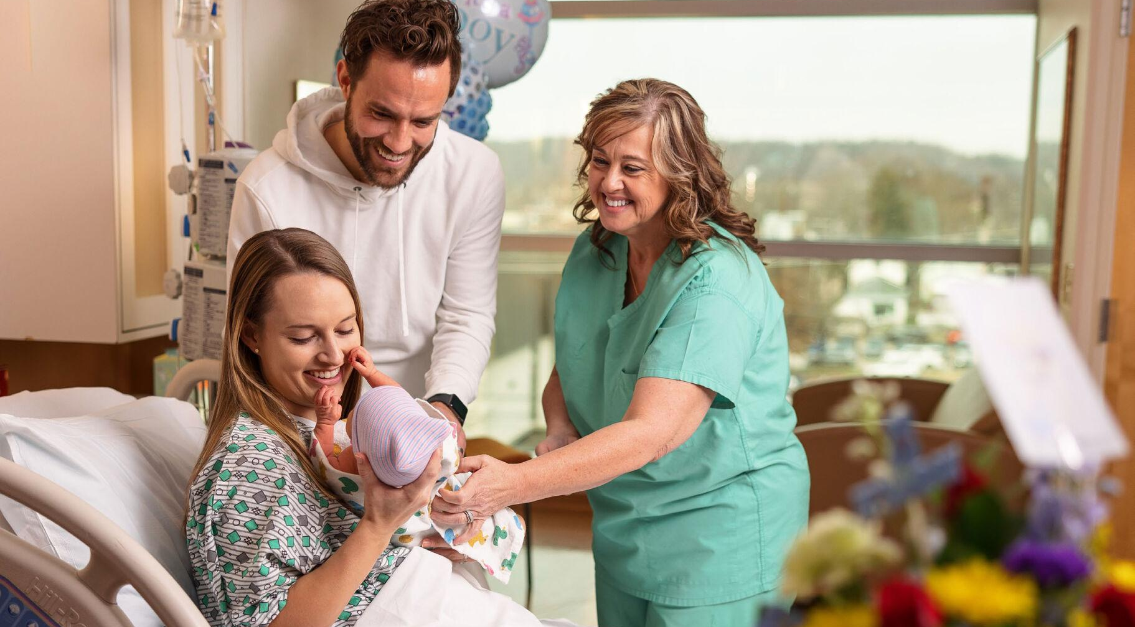
POSTPARTUM HANDOFF
SCENARIO 2
Fiona delivered a baby boy vaginally at 1343
Baby Isaac report: Baby boy weighed 7 lbs 6 oz Apgars 8/9 Mom is planning to breastfeed Vitamin K and Erythromycin given Parents want circumcision Desires Hepatitis B Vaccine Latched at 1410 for 15 minutes | Maternal Fiona report: 1st degree laceration QBL 287 ml A positive blood type GBS negative Hoping to avoid narcotics - ibuprofen for pain management Epidural removed at 1445 Has not yet stood, legs are still heavy
Notes:
Postpartum handoff does not usually need a huddle but it is an important time to use the information gathered in the handoff to begin the TeamBirth board before any actual huddle occurs
*Read slide. You may want to print out the scenario details for people to reference in hand, see the Training Scenarios resource Scenario Prompt B - Fiona.*

Slide 55
POSTPARTUM HANDOFF
SCENARIO 2
PRACTICE
What would you write on the board based on the maternal and newborn report?
Notes:
What would you write on the board based on the report you just received?
*After providing instruction, you may go back to the previous to show the scenario details again. You may instruct people to talk in small groups or have a discussion with everyone together.*

Slide 56
POSTPARTUM HANDOFF @ 1600
SCENARIO 2
Fiona & baby Isaac
Harini - sister
Misha (nurse) - 20071
Dr. Sugar (Baby’s)
Dr. Chien (Fiona’s)
Call Misha when you need to pee - Don’t get up without me!
Call dietary @ 1-17192 to order dinner!
Call with any questions about bleeding or pain
Next Ibuprofen can be given at 11:00 pm
breastfeed on demand
next attempt by 5:00 pm or when baby wakes
Mom and Harini, track wet & dirty’s in PP handbook
bath baby sometime tomorrow
Bath in room
Sleep!
Breastfeeding, needing help from lactation
Hoping to avoid pacifiers
hoping to avoid narcotics
desires circumcision
desires hepatitis B
okay with visitors during the day
as needed
on request
Notes:
This is an example of what the board may look like after postpartum transfer (with or without an actual huddle).
*Feel free to show this or just talk through what the team has written on the board compared to these examples.*

Slide 57
SHIFT CHANGE @ 1900
SCENARIO 2
Fiona & baby Isaac
Harini - sister
Misha (nurse) - 20071
Dr. Sugar (Baby’s)
Dr. Chien (Fiona’s)
Call Misha when you need to pee - Don’t get up without me!
Call dietary @ 1-17192 to order dinner!
Call with any questions about bleeding or pain
Next Ibuprofen can be given at 11:00 pm
breastfeed on demand
next attempt by 5:00 pm or when baby wakes
Mom and Harini, track wet & dirty’s in PP handbook
bath baby sometime tomorrow
Bath in room
Sleep!
Breastfeeding, needing help from lactation
Hoping to avoid pacifiers
hoping to avoid narcotics
desires circumcision
desires hepatitis B
okay with visitors during the day
PRACTICE
What might the nurse update on the board?
as needed
on request
Notes:
Now there hasn’t been any changes that require a huddle but the night shift nurse is coming on and planning for the night.
What might the oncoming nurse update on the board?
*You may instruct people to talk in small groups or have a discussion with everyone together.*

Slide 58
SHIFT CHANGE @ 1900
SCENARIO 2
Fiona & baby Isaac
Harini - sister
Jack (nurse) - 20068
Dr. Sugar (Baby’s)
Dr. Chien (Fiona’s)
Cluster Care (call us when you’re awake!)
Sleep between feeds & shower in AM
Next Ibuprofen at 11pm - with vitals
Call with questions about bleeding or pain
breastfeed - next attempt by 8:00 pm or when baby wakes
No more than 3 hours
Mom and Harini, track wet & dirty’s in PP handbook
Hearing screen overnight & bath baby sometime tomorrow
Bath in room
Sleep!
Breastfeeding, needing help from lactation
Hoping to avoid pacifiers
hoping to avoid narcotics
desires circumcision
desires hepatitis B
okay with visitors during the day
as needed
on request
Notes:
This is an example of what the board may look like after evening shift change (with or without an actual huddle). The text in blue is what the night nurse updated.
*Feel free to show this or just talk through what the team has written on the board compared to these examples.*

Slide 59
NEWBORN CHANGE IN PLAN OF CARE
SCENARIO 2 - HUDDLE 1
There is a change in the newborn plan of care
Baby Isaac received his standard newborn screening and it showed an elevated bilirubin
Last breastfeeding went well 2 hours ago
2 wet and dirty diapers today so far
Hyperbilirubinemia protocol [is to recheck bilirubin after 6 hours and ensure feedings are within 3 hours]
Notes:
*Update the slide or do a voice over of your specific hyperbilirubinemia protocol, and, if you want, you can include a bilirubin value relevant to this scenario.*
Now time has passed and there is a change for baby Isaac: *Read slide.*
Would you all initiate a huddle with the pediatrician at this point?
*There is no wrong answer and it is up to you and your teams to decide what you want to the standard to be at your facility. You may want to print out the scenario details for people to reference in hand, see the Training Scenarios resource Page 3: Scenario Prompt A - Fiona.*

Slide 60
NEWBORN CHANGE IN PLAN SCENARIO 2
Fiona & baby Isaac
Harini - sister
Jack (nurse) - 20068
Dr. Sugar (Baby’s)
Dr. Chien (Fiona’s)
Cluster Care (call us when you’re awake!)
Sleep between feeds & shower in AM
Next Ibuprofen at 11pm - with vitals
Call with questions about bleeding or pain
Recheck labs in 6 hours
Breastfeed on demand, no longer than 3 hours, call with next latch so we can support
Discuss possible need for phototherapy
Bath in room
Sleep!
Breastfeeding, needing help from lactation
Hoping to avoid pacifiers
hoping to avoid narcotics
desires circumcision
desires hepatitis B
okay with visitors during the day
as needed
on request
when Isaac’s labs come back
Notes:
For purposes of demonstration, we’ll say that the Hyperbilirubinemia protocol does not yet require a call to the pediatrician so while this is a change in the plan of care, our facility has decided it doesn’t yet require a huddle. The nurse informs the patient, provides any necessary education, and updates the board accordingly so there is clarity on the plan for baby and when the next huddle will happen.
We know that depending on the lab results, there may be need for a conversation with the pediatrician so including that in the Next Huddle section helps keep the team up to date.
*Update this board however is relevant to your unit protocol especially if most people would have a huddle with the pediatrician at this point.*

Slide 61
NEWBORN CHANGE IN PLAN OF CARE
SCENARIO 2 - HUDDLE 1
Bilirubin recheck at 32 hours of life: 12 umol/L
Hyperbilirubinemia protocol indicates to notify pediatrician for updated orders
“Hi Dr. Sugar, my name is Adelisa the nurse caring for Baby Isaac. I am calling to start a huddle at the bedside with Fiona, Isaac’s mother, and her sister Harini, and we want to talk about next steps based on Isaac’s current high risk bilirubin of 12 at 32 hours of life.”
Notes:
*Update the slide or do a voice over of your specific hyperbilirubinemia protocol, and, if you want, you can include a bilirubin value relevant to this scenario.*
Now that the lab results have returned, the nurse sees that the value should spark a huddle with Dr. Sugar, the on call pediatrician, in order to discuss next steps for baby Isaac. She goes to the bedside and initiates a huddle over speaker phone saying: *Read slide.*
*You may want to print out the scenario details for people to reference in hand, see the Training Scenarios resource Page 3: Scenario Prompt A - Fiona.*

Slide 62
NEWBORN CHANGE IN PLAN OF CARE
SCENARIO 2 - HUDDLE 1
PRACTICE
Discuss as a group what the conversation might be between Fiona, the nurse, Dr. Sugar, and Harini.
How might the Baby’s plan on the board need to be updated?
What questions or concerns might you expect from Fiona or Harini?
Cluster Care (call us when you’re awake!)
Sleep between feeds & shower in AM
Next Ibuprofen at 11pm - with vitals
Call with questions about bleeding or pain
Recheck labs in 6 hours
Breastfeed on demand, no longer than 3 hours, call with next latch so we can support
Discuss possible need for phototherapy
as needed
on request
when Isaac’s labs come back
Notes:
The nurse would include any additional relevant assessment information or context with Dr. Sugar and Dr. Sugar would share treatment options, discuss any orders, and answer any questions Fiona or Harini have.
How do you think Baby Isaac’s plan might be updated on the board?
What questions or concerns might we expect from Fiona or Harini?
*You may want to print out the scenario details for people to reference in hand, see the Training Scenarios resource Page 3: Scenario Prompt A - Fiona.*

Slide 63
NEWBORN CHANGE IN PLAN SCENARIO 2
Fiona & baby Isaac
Harini - sister
Jack (nurse) - 20068
Dr. Sugar (Baby’s)
Dr. Chien (Fiona’s)
Cluster Care (call us when you’re awake!)
Sleep between feeds & shower in AM
Next Ibuprofen at 11pm - with vitals
Call with questions about bleeding or pain
begin phototherapy at bedside
breastfeed on demand (but wait no longer than 3 hrs)
supplement post feed with formula
recheck labs in 6 hours
Bath in room
Sleep!
Breastfeeding, needing help from lactation
Hoping to avoid pacifiers
hoping to avoid narcotics
desires circumcision
desires hepatitis B
okay with visitors during the day
With pediatrician when the labs come back
as needed
on request
Notes:
This newborn huddle for hyperbilirubinemia may result in a board update that looks like this: ensuring any orders or next steps from the discussion are included in the baby section and the Next Huddle.
*Update this board however is relevant to your unit protocol especially if most people would have a huddle with the pediatrician at this point.*

Slide 64
Practice Scenario: Incorporating Doulas

Slide 65
Incorporating doulas into huddles
Birthing Person
Clinicians
Nurse Physician (OB hospitalist, Attending OB, Resident)
Support Person
Doula

Slide 66
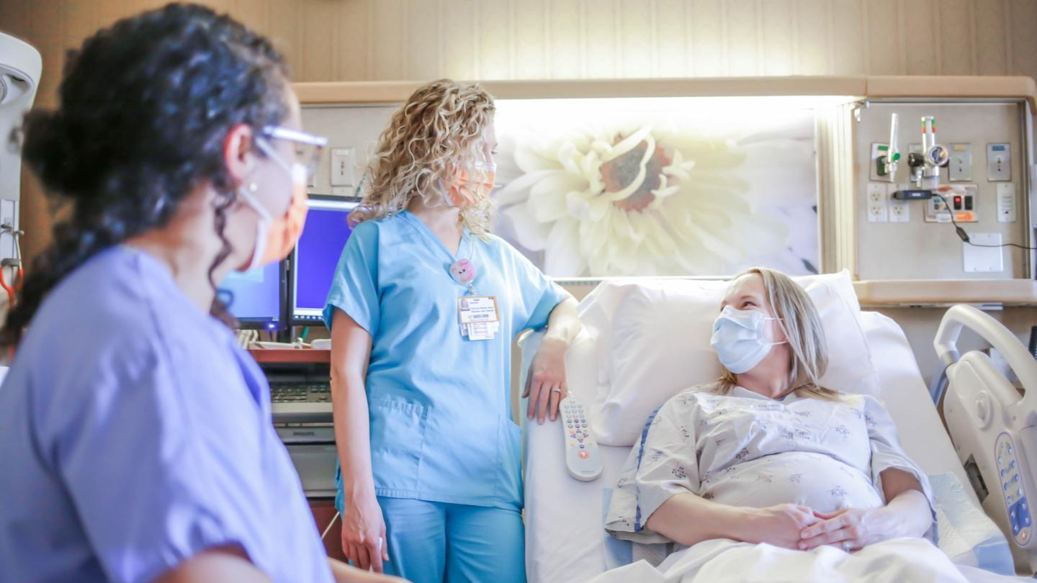
DOULAS
SCENARIOS AND PRACTICE
DURING ADMISSION, BEFORE A HUDDLE
While getting Kelsey settled, Nurse Trisha asked if she has a birth plan or wants to share any specific birth preferences. Kelsey shares that she started a birth plan with her doula Isabel but didn’t end up finishing it since she knows so much can change.
Doula: “Yes! We started to talk about some of Kelsey’s hopes for labor and birth, knowing of course that things can change. I’m here to support her in having a positive experience in any case.”
Nurse: Yes, it’s ok either way. You can tell us things that are important to you anytime throughout your stay. What’s on your mind right now?
Kelsey: “Well, I’m interested in trying to go natural for as long as possible and trying some pain-coping techniques with Isabel, like walking around, massage, and bouncing on the ball. I do know I want Niko to come up here (Kelsey pats her heart 🩷) right after birth, and I want to try breastfeeding as soon as possible. And I want my aunt Yara to be with Niko if there’s any time I can’t be.”
Notes:
[read or act out slide]

Slide 67
DURING ADMISSION
BEFORE A HUDDLE
Kelsey & Baby Niko
Isabel - Doula
Yara - Auntie
Trisha - Nurse
Whitney - Midwife
go natural as long as possible
pain coping with Isabel
Niko to Kelsey’s chest right away
breastfeed ASAP
Kelsey or Yara with Niko all the time
when Whitney comes in
Notes:
The nurses likely wrote out and updated the team section at some point during the admission, she then says: “Ok, those things are important preferences to know about your birth. Isabel, would YOU mind writing those things over here on the shared planning board while I get the IV supplies? Can you list those things here (point to the right side of the preferences section on the board) and leave room for other preferences and concerns Kelsey may have along the way?
Bring the doula in to board use right away and coach them about how to update it during and between huddles.
We see here that Isabel wrote in patient friendly language the preferences that Kelsey shared.
Then the nurse might prep them for an upcoming huddle by saying: “Kelsey, be thinking about what matters to you now, so when Whitney the midwife comes in, we'll talk together and make a plan - called a TeamBirth huddle - and you, Isabel, and Yara when she gets here, are encouraged to participate and share your thoughts as we make a plan.”

Slide 68
DOULAS
SCENARIOS AND PRACTICE
ADMISSION HUDDLE
Midwife: “Okay, let’s huddle! Nurse Trisha let me know that your water is broken. Lots of first-time mamas have their water break first before labor starts. We can discuss a few options to ensure your labor continues progressing. I see that you are hoping to go natural as long as possible, so a first step could be walking around and bouncing on the ball with support from your doula and sister. We will monitor you closely in case there's any indication for augmenting your labor medically with Pitocin."
Kelsey: “That sounds good. I remember hearing about Pitocin during a prenatal visit and from Isabel. I think Yara had Pitocin too for her labor and found it to be really painful.”
Notes:
At some point the provider comes by and the nurse might initiative a huddle by saying: “Why don’t we do a round of introductions and have a TeamBirth huddle. Right now, we’re hoping to make a plan together with Kelsey and Isabel and note it on the board.”
[read or act out slide]

Slide 69
DOULAS
SCENARIOS AND PRACTICE
ADMISSION HUDDLE
Midwife: “Right, so when your water breaks and you’re not in labor, we often give Pitocin to get it going. [explains pitocin]”
Kelsey: “Oh–am I not in labor? I’ve been having contractions ever since my water broke.”
Nurse: “The monitor shows you’re having contractions every 3-5 minutes, but you don’t seem to notice most of them. Does that sound right?”
Doula: “Kelsey was squeezing my hand and breathing really hard every 10 minutes, I’ve been timing it. Now she's doing that every 6 or 7 minutes, and she is squeezing my hand a lot harder. So I think Kelsey maybe is in labor?
Notes:
[read or act out slide]
The team goes on discussing early labor and what the options are for the labor progress plan.

Slide 70
ADMISSION HUDDLE
Kelsey & Baby Niko
Isabel - Doula
Yara - Auntie
Trisha - Nurse
Whitney - Midwife
Eat a snack!
Move around
Listen on & off
go natural as long as possible
pain coping with Isabel
Niko to Kelsey’s chest right away
breastfeed ASAP
Kelsey or Yara with Niko all the time
try lots of moves now
start Pitocin later if needed
as needed
in 2-3 hours
after the next exam, if we need to
Notes:
It is important to note that in this scenario we’re assuming the provider and nurse elicited Kelsey’s full understanding of the options between expectant and active management–when demonstrating TeamBirth, or practicing huddles, try not to get derailed with the clinical details of each situation.
As you support training at your sites, we want to emphasize that for scenario based huddle practice you don’t need to get into the weeds of clinical management unless you are intentionally leaving time to do parallel competency training that includes both clinical objectives in addition to the TeamBirth communication objectives.
Otherwise, primarily focus on the communication aspects to ensure that every clinician understands the key behaviors and how to write that information in patient friendly language on the board.
So based on the discussion Kelsey, Isabel, Trisha, and Whitney have during the huddle, the board gets updated to reflect the conversation. Ensuring language is clear and patient friendly. Throughout the doula is an important resource to help ensure things are clear

