Slide 1
COVID-19 Induced PTSD Prevention and Treatment
New Jersey Health Care Quality Institute 2021 Leapfrog Conference
January 27, 2021
Prepared by
Donald J. Parker, President
HM Carrier Clinic

Slide 2
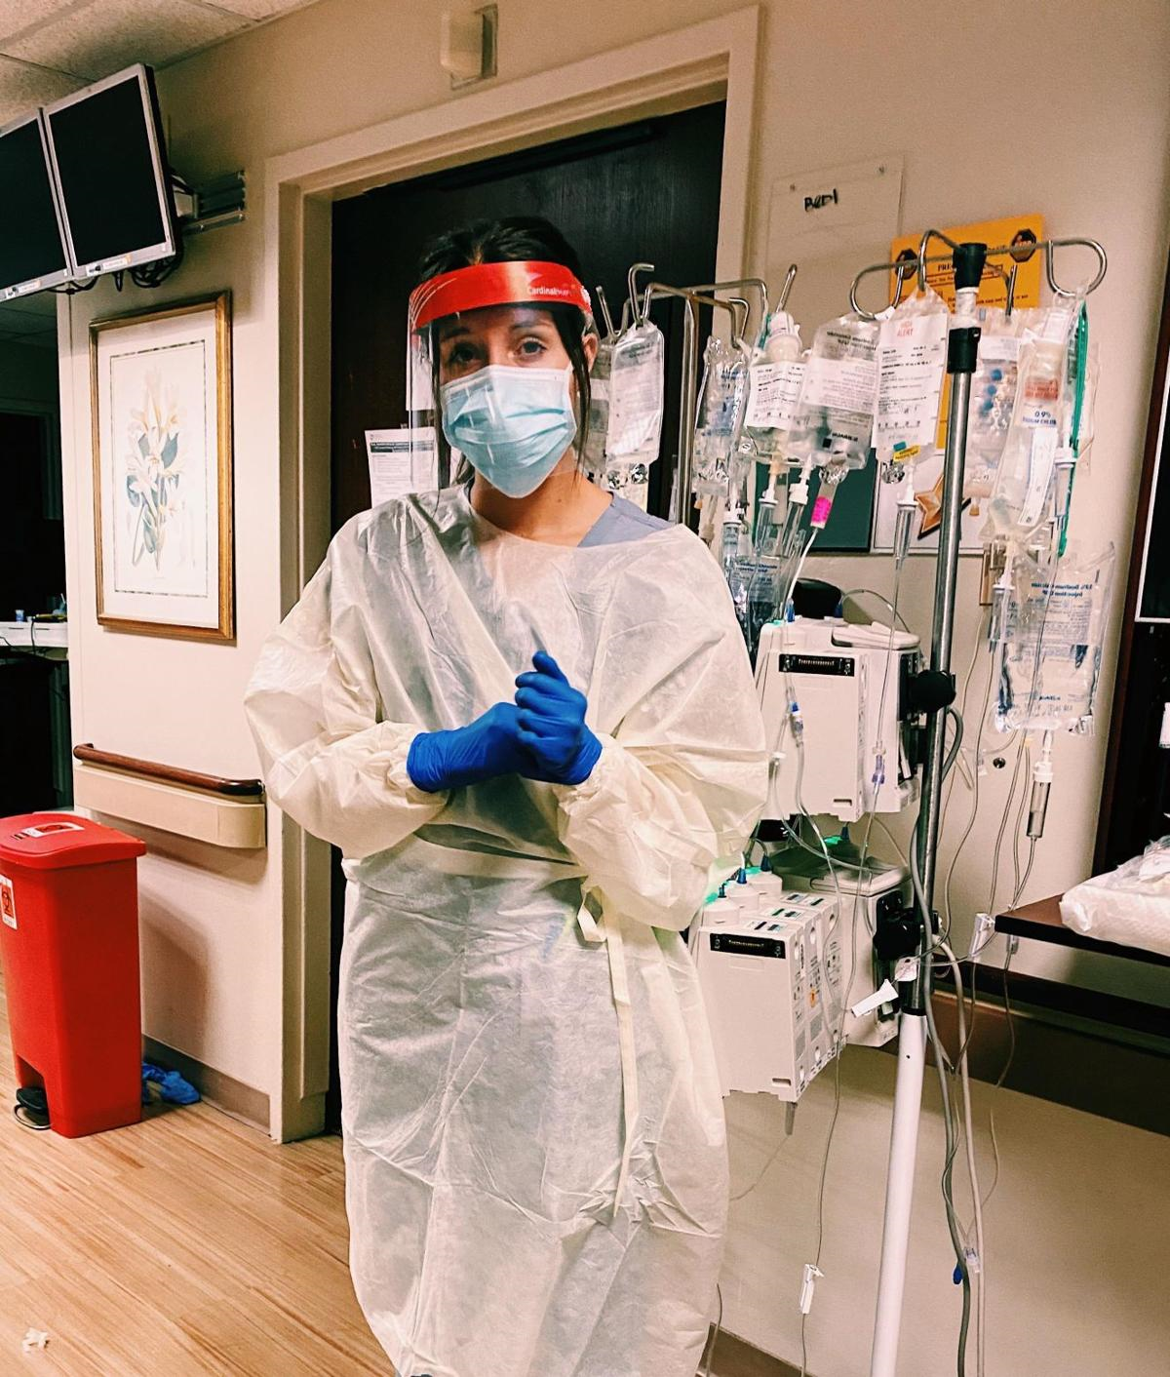
“Breathing labored, shallow
breaks the cadence of quiet sleep
fever and pain punch different clocks…
fluid streams in weathered arms
to kill the parasite invading
I look over my domain of 88 beds
always full, and I wonder about a lot of things
Night and darkness always do that”
Karen Trew
Nurse

Slide 4
Quotes from the Front Line:
Emotional Impact and Safety Concerns
I wouldn’t be able to live with myself if someone I love got sick because of me.
I am in one of the “high risk” groups. I woke up every morning searching for some indication that I might have this virus. I count the days from when I could have last been exposed. Then I go to work again and start from the beginning.
I’m having a hard time sleeping. I keep waking up dreading going into work.

Slide 7
Toolkit for Emotional Coping for Healthcare Staff
Learn and use evidence-based tools for coping
Tools are based on:
Cognitive-behavioral therapy skills
Skills for groups and families
Self Help
24 hr. – 7 day a week Access
Customized care
Reducing barriers to Access
De-stigmatization of Behavioral Health
Strengths based strategies

Slide 8
Hackensack Meridian Health COVID-19 Team Member Resources for Emotional Well-Being
Health System Chief Wellness Officer- Dr. Amy Frieman
Employee Assistance Program – Life Solutions
We Care Program – Confidential support program for team members and physicians 24-hour hotline maintained by volunteers for Behavioral Health CTS.
Coping with COVID talks – Behavioral Health CTS volunteers lead group session focused on evidence-based technologies to build resilience tailored for groups and individuals.

Slide 9
COVID-19 Team Member Resources for Emotional Well-Being
Bravowell – Stress reduction, home workouts, nutritional counseling, finances and more designed for tablet or smartphone access.
Virtual Integrative Health and Medicine Visits – Health Psychologist consultations (live or telephonic) focused on preventing/managing burnout and PTSD.
Caring for Self Series:
Mindful Moment Meditation- 7 days, 5 live sessions a day
Self Care Series – 5 days, 3 sessions a day
Integrative Nutrition – 7 day virtual appointment with Integrative Nutritionist

Slide 10
COVID-19 Team Member Resources for Emotional Well-Being
Post Shift Stress Debriefing:
Neuropsychologists on call for debriefing of staff in high concentration COVID-19 units.
Focus on building group/team resilience.
Heartmath:
Personal instruction for system leaders using mind body training to improve stress management an health.
Team Member Benefits Redesign

Slide 11
COVID-19 Team Member Resources for Emotional Well-Being
Team Mate Benefits Redesign
Eliminate co-pays for Behavioral Health
Expand panels
Engage all system Behavioral Health providers in insurance panels
Mental Health First Aid:
Training management team in Mental Health First Aid to assist in identification, management and referral of teammates experiencing behavioral issues.
One Mind at Work:
Engaging the entire health system in eliminating the stigma associated with mental health.

Slide 12
New Resources for our Patients
Behavioral Health Urgent Care
Telepsychiatry Visits
Integrative Strategies
New Technologies
Hypothalamic Stimulation
Acoustical Stimulation
Electronic Acupuncture Assisted Detox
Voice Recognition Software

Slide 13
ADDITIONAL RESOURCES
▪ Ten Percent Corona Virus Sanity Guide https://www.tenpercent.com/coronavirussanityguide
▪ Headspace
https://www.headspace.com/covid-19
▪ Calm
https://blog.calm.com/take-a-deep-breath
▪ Psychological First Aid
https://www.r4r.support/resources
▪ Meditation for Leadership
https://youtu.be/8pqG9AXdNqA
▪ Coping with Stress During COVID-19
https://www.cbtdbtassociates.com/blog/remote-resources-cope-social-distancing-self-quarantine-covid-19-2/
▪ NJ Mental Health Cares
1-866-202-HELP (4357)

